Slide 1
29 Acres
Utah Autism Academy
Settings Rules
Open discussion

Slide 2
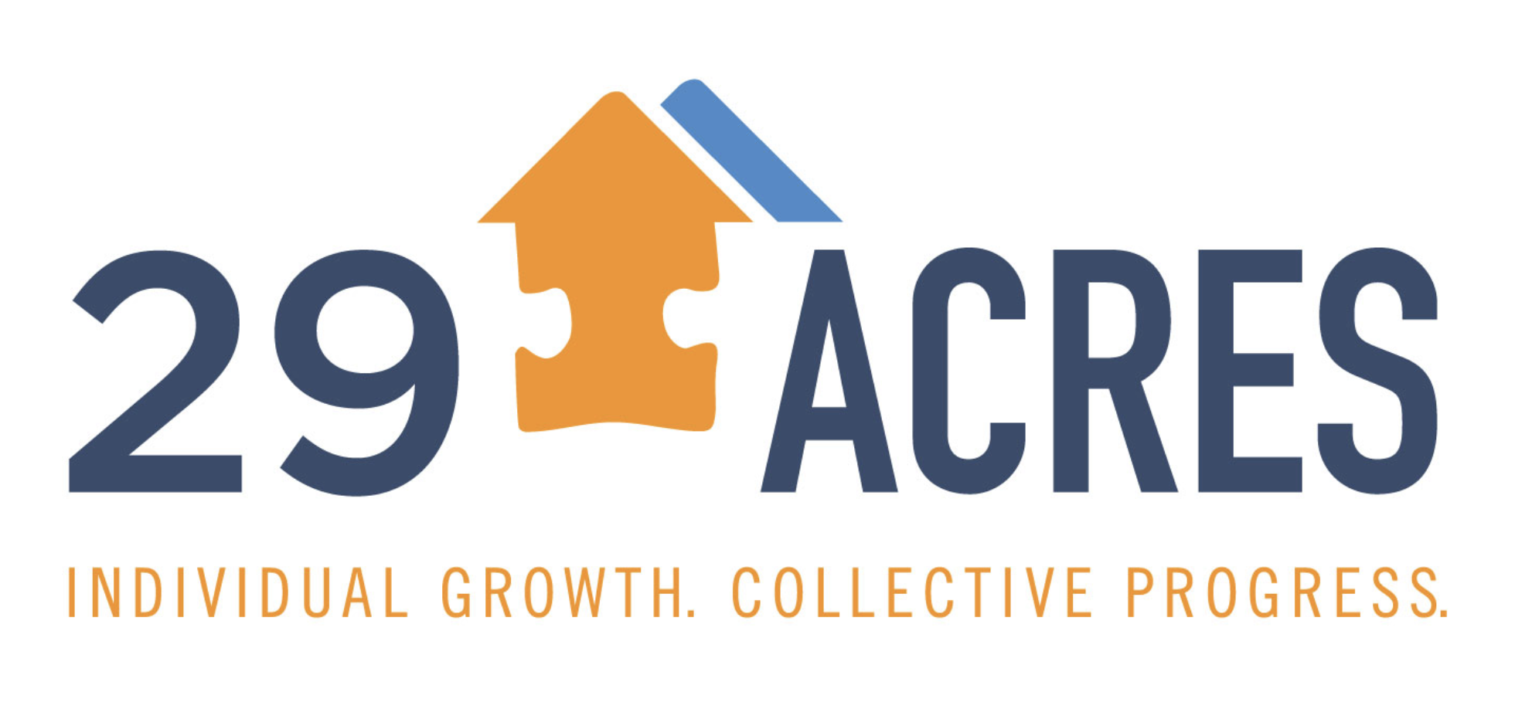

Slide 3
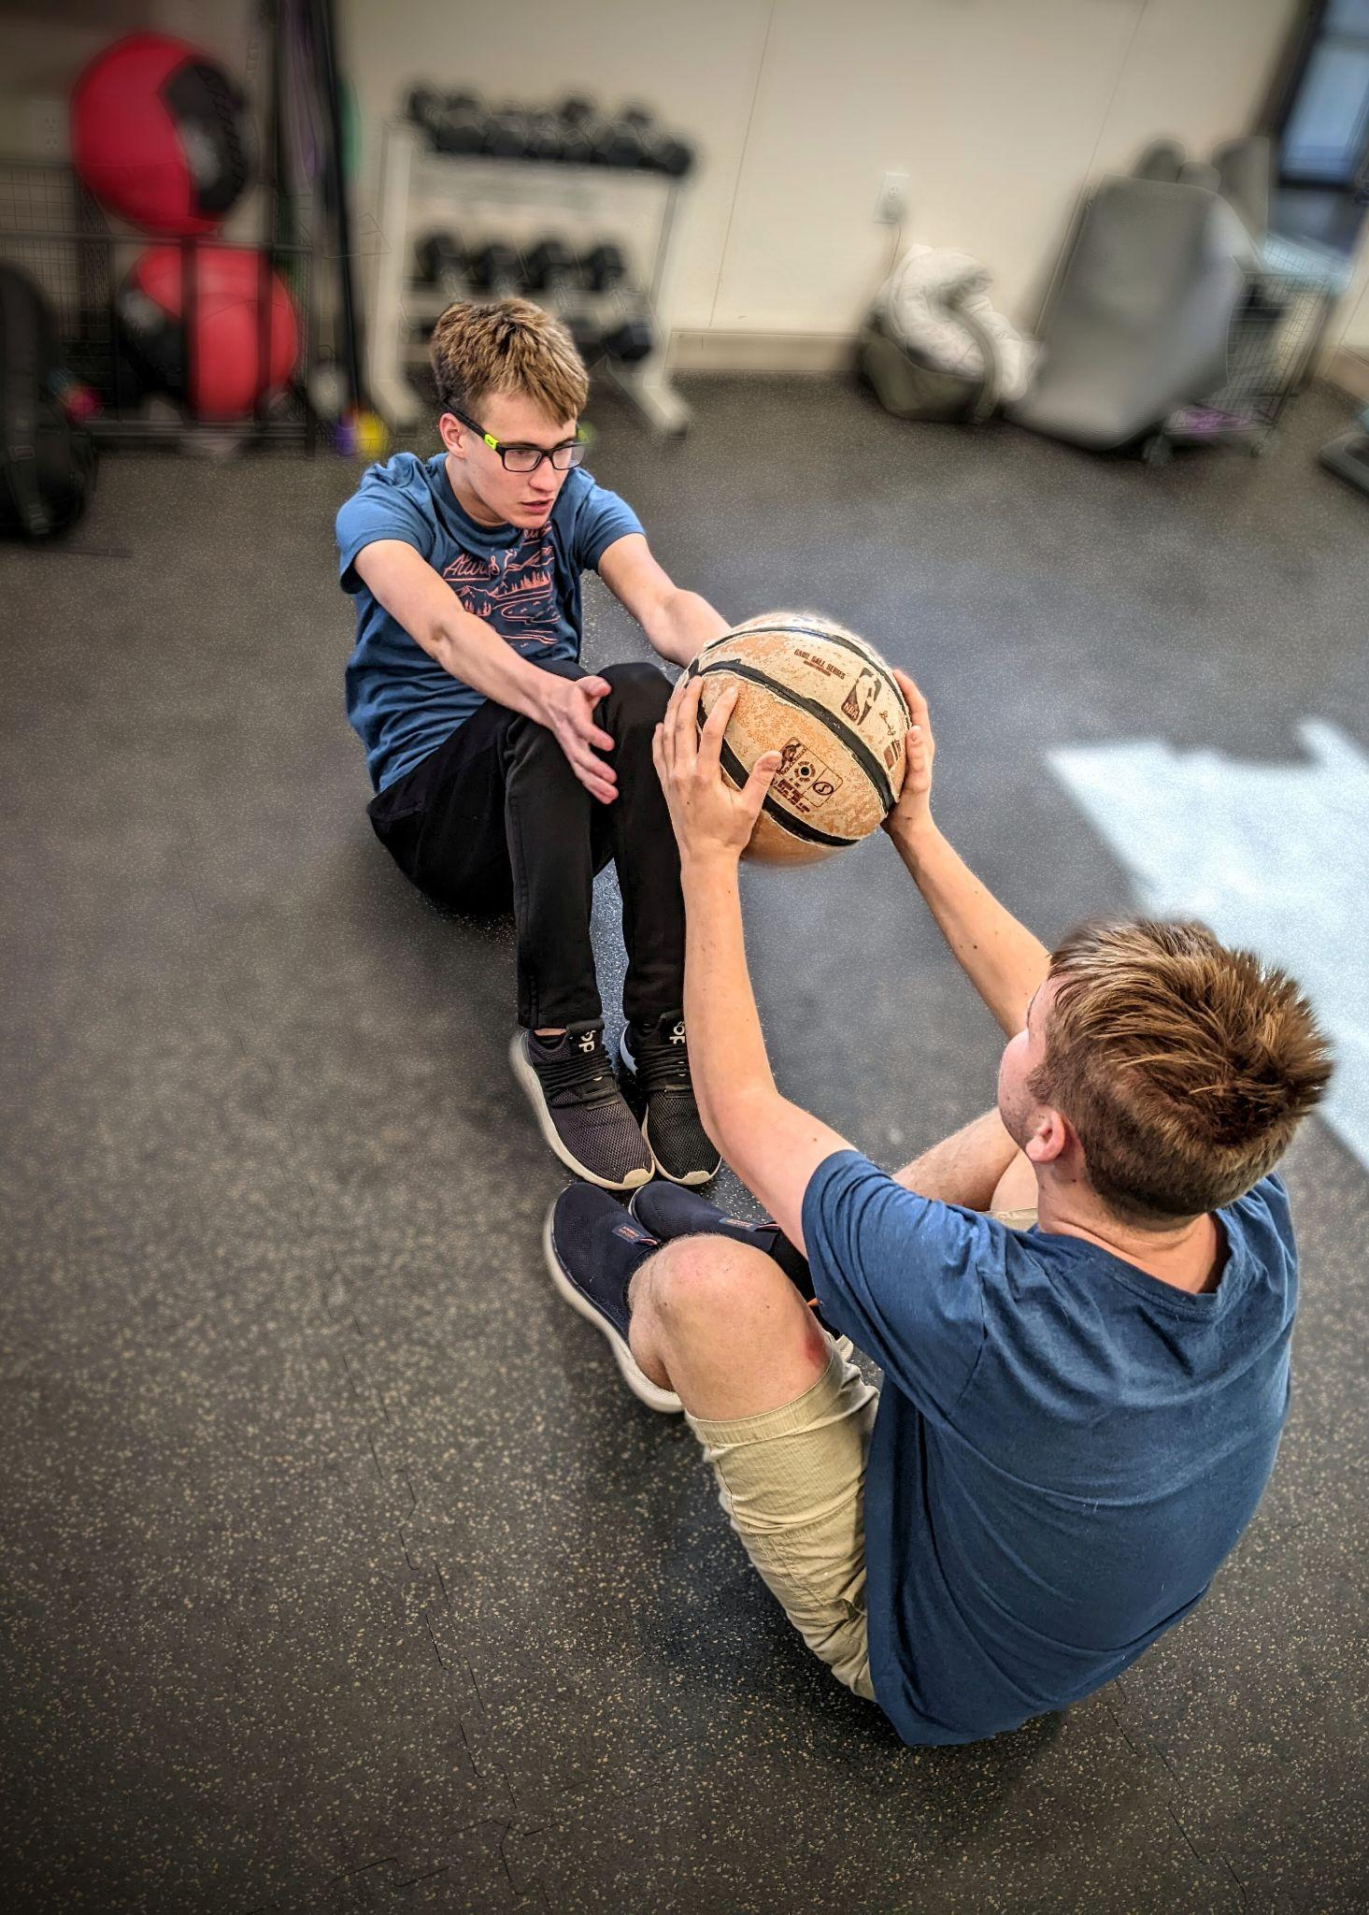
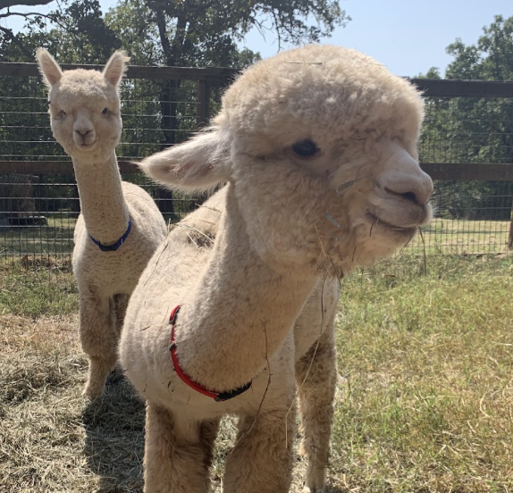
29 Acres Mission Statement
To ensure that people living with Autism and other Neurodiversities have community and a safe place to live where opportunity and happiness are the standard.
Notes:
We are editing our mission statement to include our staff our goal of being a culture-keeper .

Slide 4
29 Acres Mission Statement
29 Acres was founded by a group of families who share a similar need: Finding quality programming and safe housing for their young adults with autism in North Texas.
Notes:
We are editing our mission statement to include our staff our goal of being a culture-keeper .

Slide 5
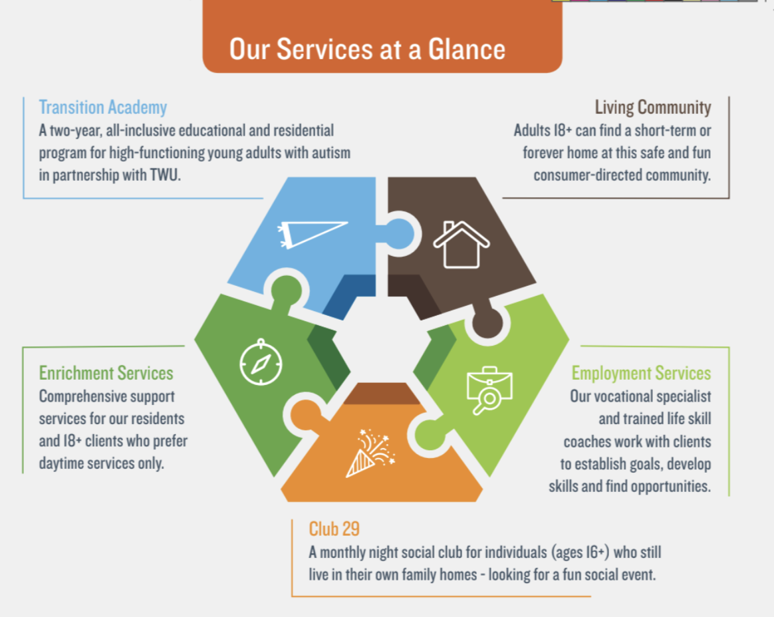

Slide 6
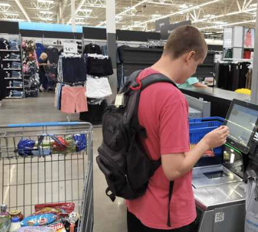
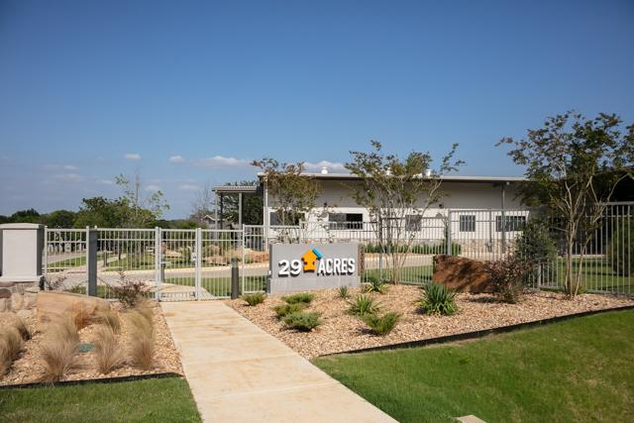
Separation
Real Estate
Support Services
Real estate and support services are two separate non profit organizations
Consumer-directed (resident chooses provider)
Person directed choice
Capture state funding for LTSS
Notes:
To align with person directed choice
To be able to capture state funding for LTSS which would not be available to our clients with other models such as assisted living

Slide 7
29 Acres Timeline
2015 29 Acres was registered as a nonprofit | August of 2018 the Transition Academy welcomed their first class of 8 students. August of 2022 we accepted our largest group of 14 students. Living in houses outside of 29 Acres property | October 2018 Groundbreaking Ceremony at the 29 Acres property. Summer of 2020 our first residents moved into the community, by December of 2022 our 10 houses will be full | January of 2022 we opened our Dallas Hub

Slide 8
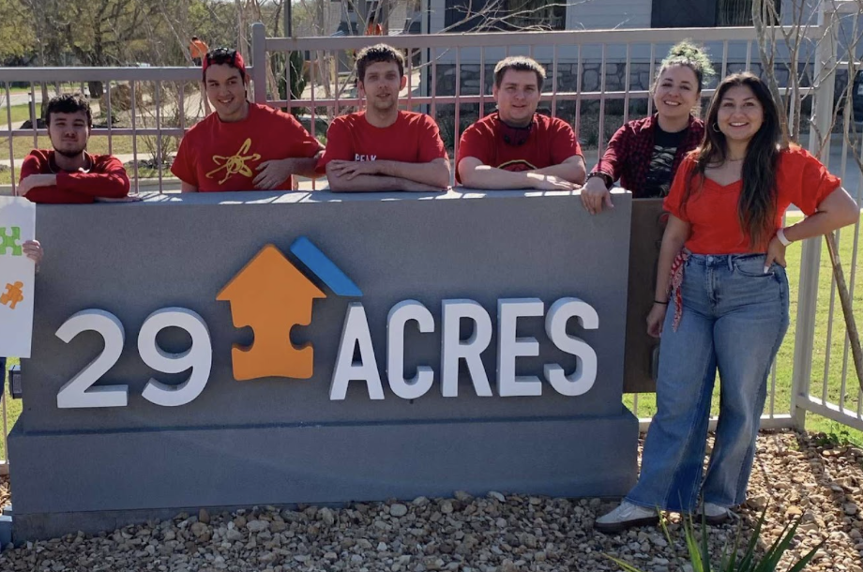
Who we support
Enrichment Services (Our LTSS)
We remain committed to providing high quality support to all support level needs
We meet each client where they are at with staffing (1:1 staffing support needs and require 24/7 oversight and others who have lower support needs and to whom we provide drop-in support only)
We have found that our support services are best directed by BCBAs
Life plans are directed by the individuals and their circles of support team and are community centered.
Residential support (Cross Roads) and day time support services (Cross Roads and Dallas)
Employment Services
Available to residents and clients still living in their family homes
Services though Texas Workforce Commission
Transition Academy
Started our 6th year of Transition Academy August 2023
Start 14 students each year
Live off 29 Acres campus
Partnership with Texas Woman's University
Notes:
Enrichment support services (our LTSS) from 29 Acres are optional. Residents can use other providers.
We currently support roughly 100 clients with our LTSS.
We remain committed to providing high quality support to all support level needs
We have individuals who choose us to provide their support services that have 1:1 staffing support needs and require 24/7 oversight and others who have lower support needs and to whom we provide drop-in support only. We meet each resident and client where they are. 5 of our houses have overnight staffing and 5 do not require overnight support. About 1/3 of our residents have high support level needs, ⅓ have drop-in support and the other ⅓ have support needs that fall in-between the two.
We have found that our support services are best directed by BCBA’s
Life plans are directed by the individuals and their circles of support team and are community centered. ( residents have access to all of their chosen communities)
29 Acres also provides employment services through TWC
We also offer day only support services to clients not ready to move out of their family homes in both Dallas and Denton.
Finally, we are in our 6th year of our residential transition academy and admit 14 new students each year.

Slide 9
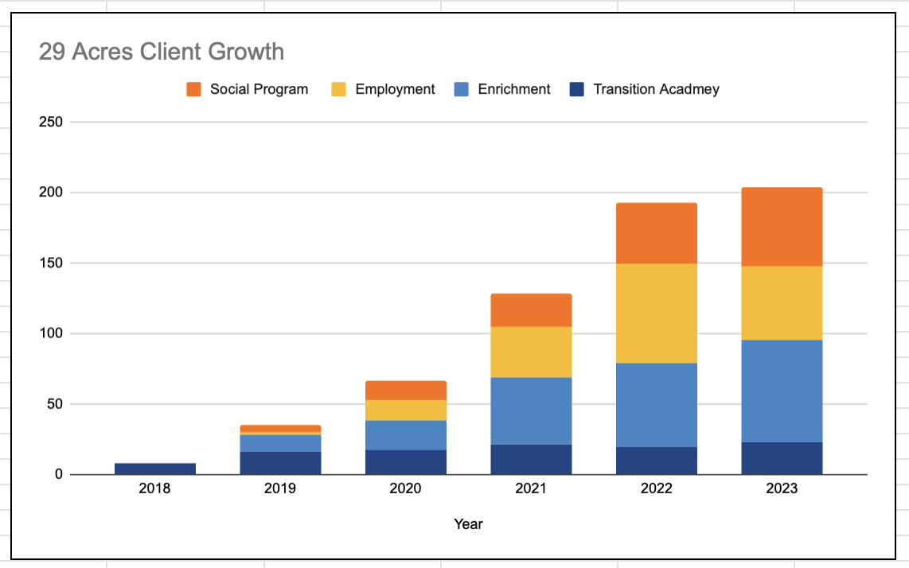
The Growth

Slide 10
29 Acres Real Estate

Slide 11
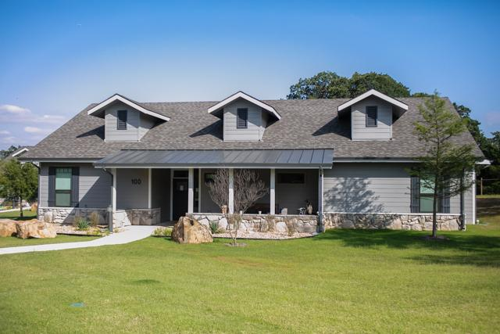
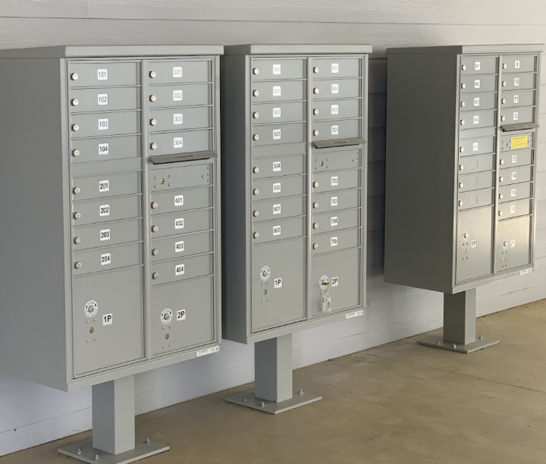
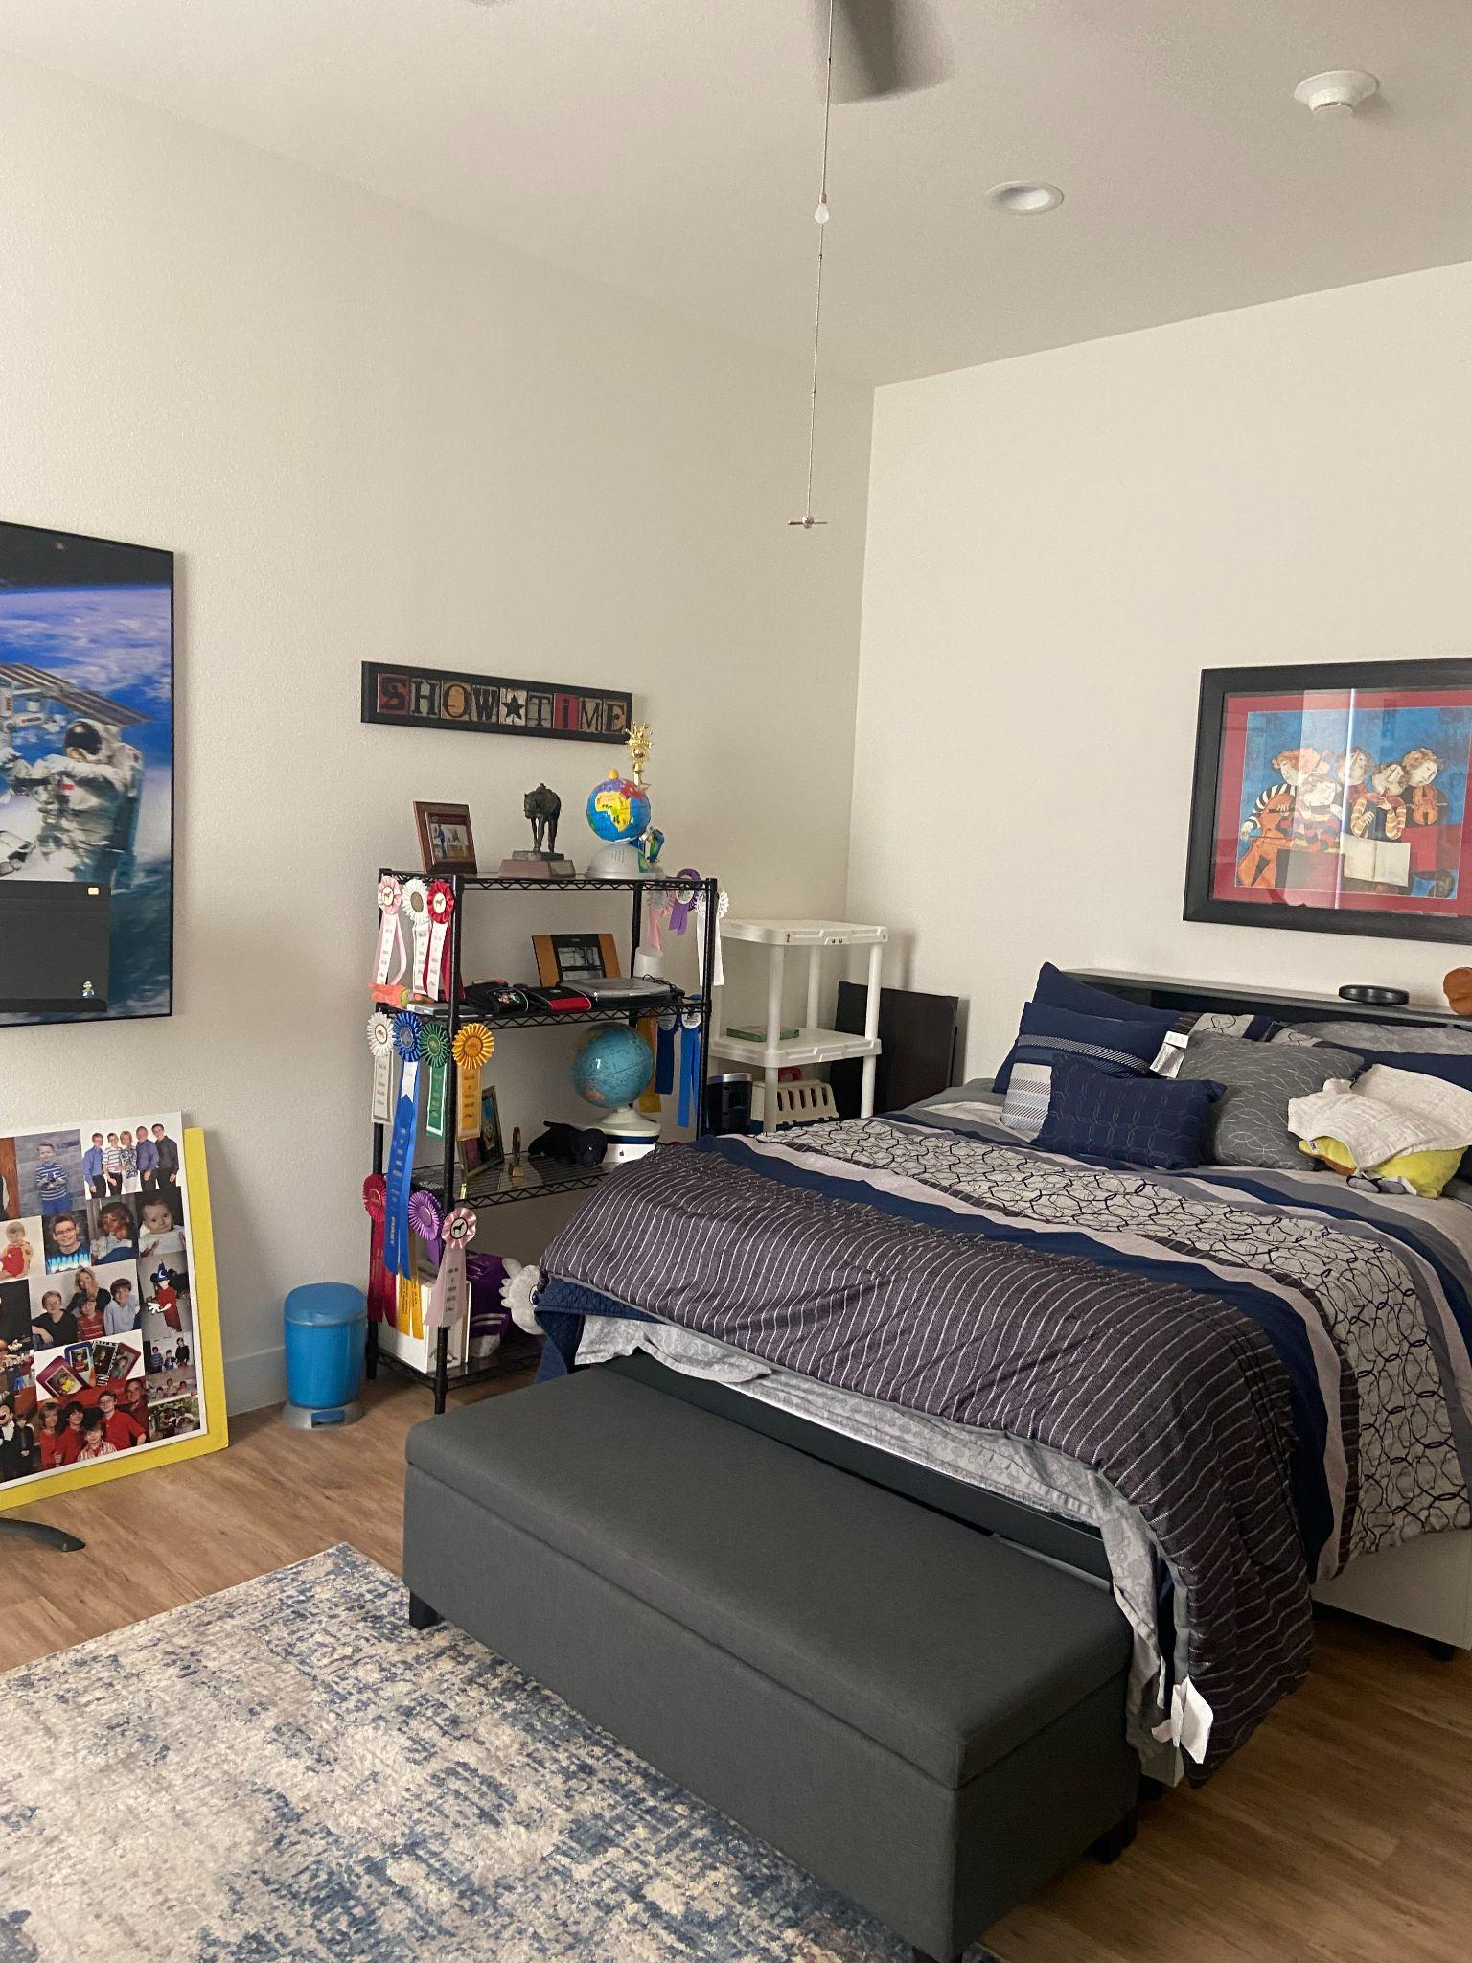
29 Acres Real Estate - Overview
44 living opportunities
10 houses with 3 different floor plans
Sized between 2800 sq ft - 3200 sq ft
Parking for residents who drive in front of houses
Centralized private mailbox space
Notes:
We currently have 44 opportunities and currently 42 individuals living at 29 Acres.
Describe the community:
10 houses 6 are 3200 sq ft open floor plan private vs. semi-private spaces and shared spaces. Back and front porches. 4, 2 stories- a little smaller (2800) :
Originally meant for TA housing, but we needed the space for long term living opportunities. TA is now completely houses off this property. Maybe describe amenities with bullet points. and insert pics
Mention that Parking for residents who drive is in front of houses.

Slide 12
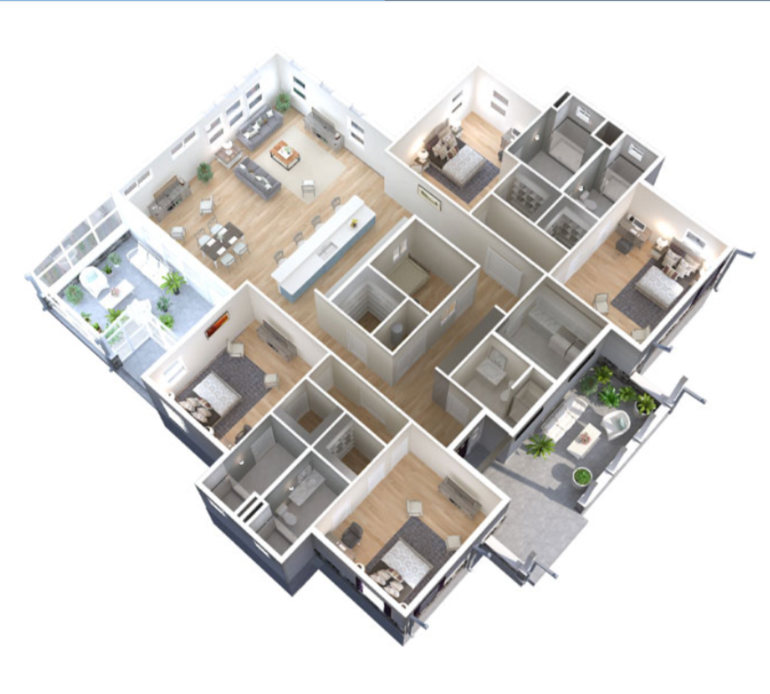
29 Acres Real Estate - Floor Plan
Open floor plan with semi-private spaces and shared spaces
Private bedroom and bathroom with locks
Screened in back patio space
Opened living and kitchen space
29 Acres provided furniture, decor and stocked kitchen
Clients decorate private space how they would like
Notes:
We currently have 44 opportunities and currently 42 individuals living at 29 Acres.
Describe the community:
10 houses 6 are 3200 sq ft open floor plan private vs. semi-private spaces and shared spaces. Back and front porches. 4, 2 stories- a little smaller (2800) :
Originally meant for TA housing, but we needed the space for long term living opportunities. TA is now completely houses off this property. Maybe describe amenities with bullet points. and insert pics
Mention that Parking for residents who drive is in front of houses.

Slide 13
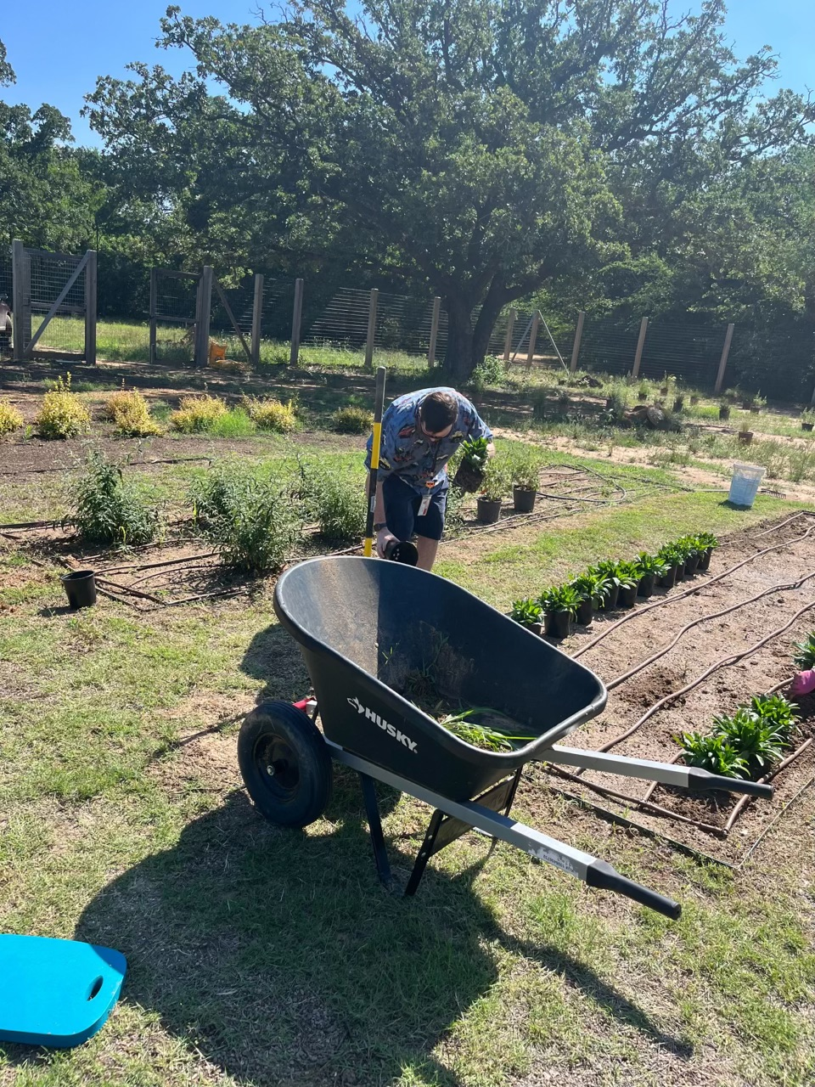
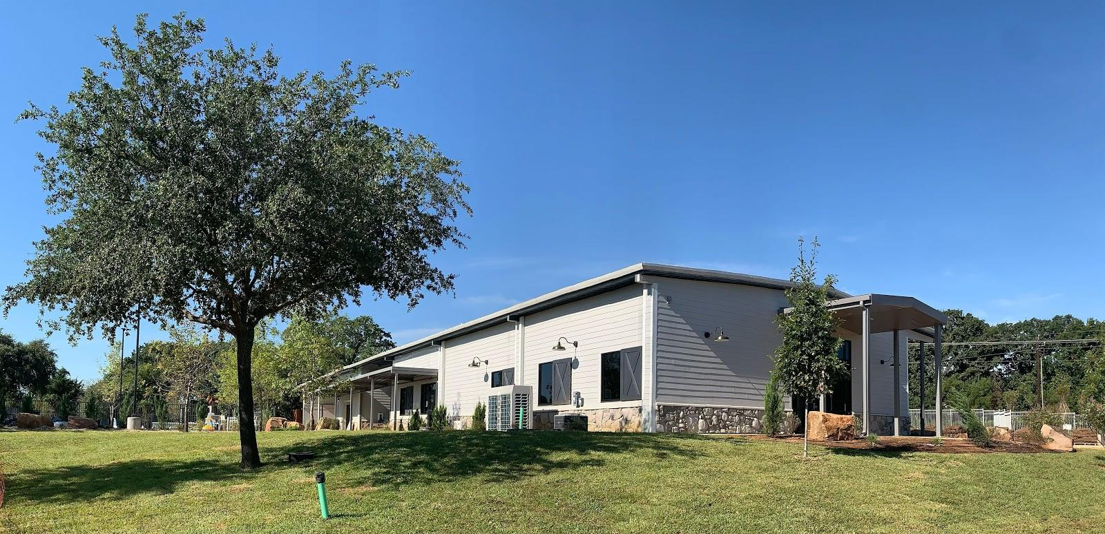
29 Acres - On Site Amenities
Community Center
Workout Room
Multi-purpose game room
Teaching commercial kitchen
Outdoor Space
Garden
Pool / hot tub
Eatery
Walk/ bike trail
Animals
Property Team
Onsite property and overnight security team
Nights and weekends event calendar

Slide 14
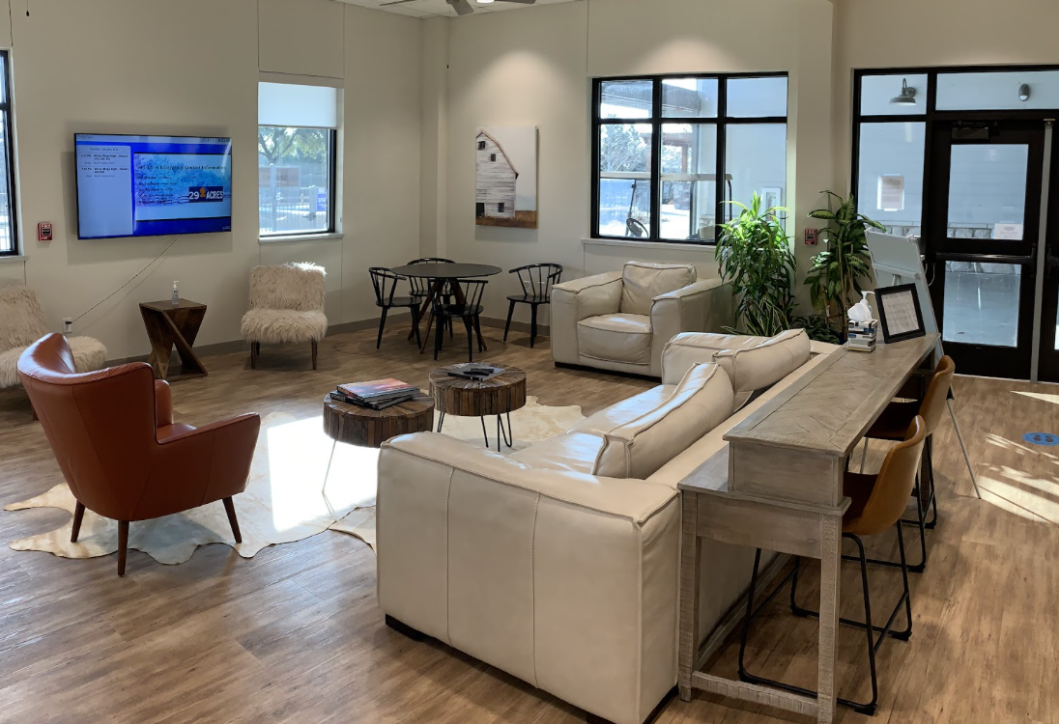
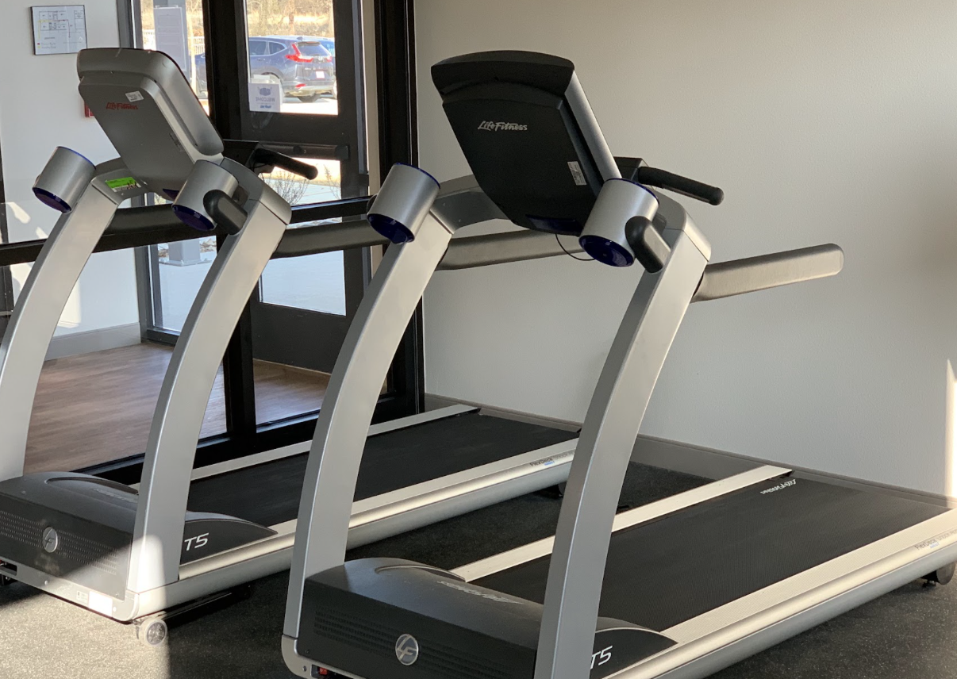
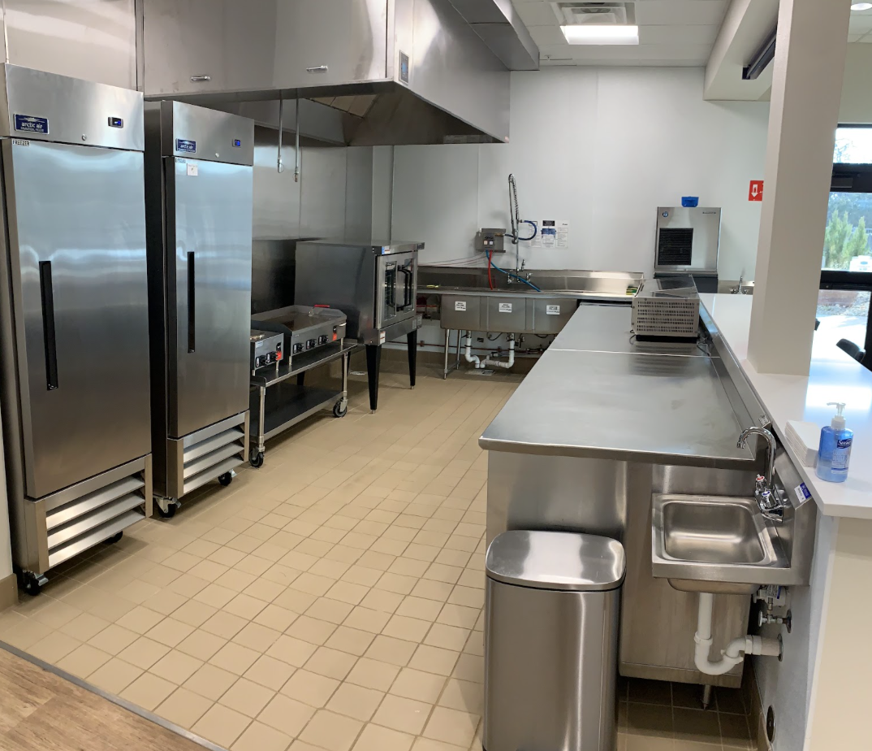
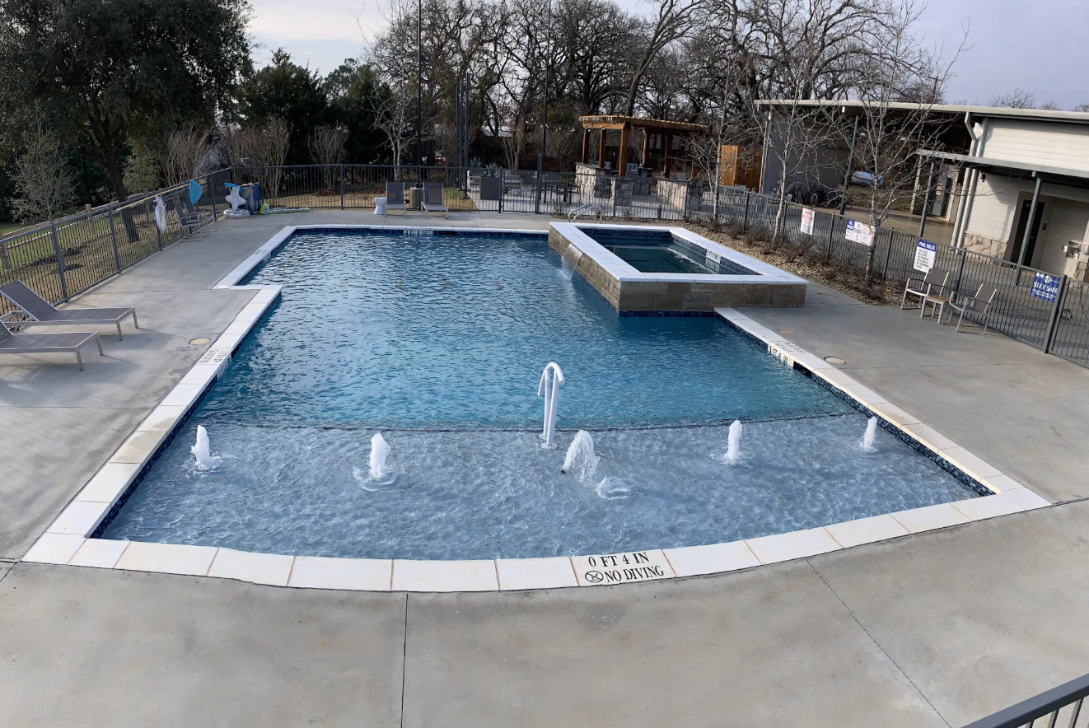
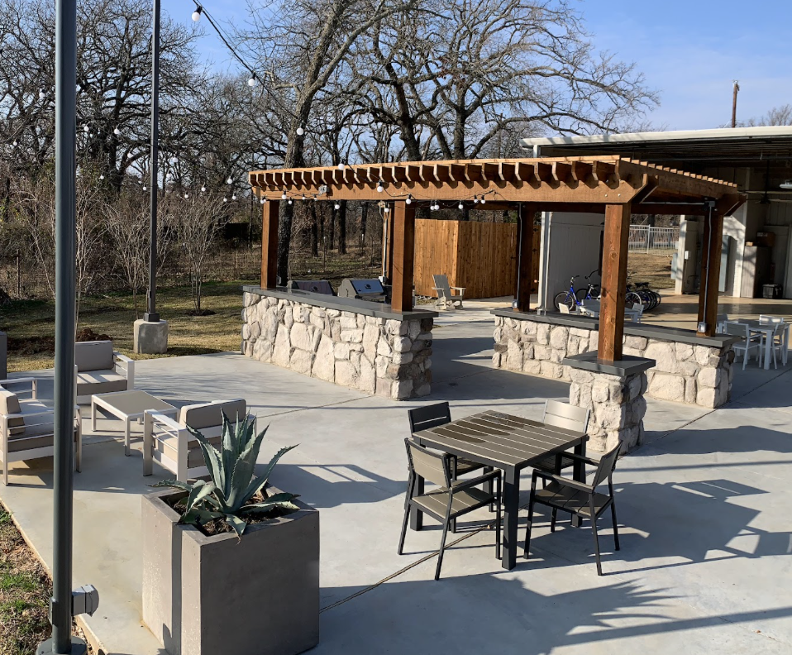
29 Acres Real Estate - Community Center

Slide 15
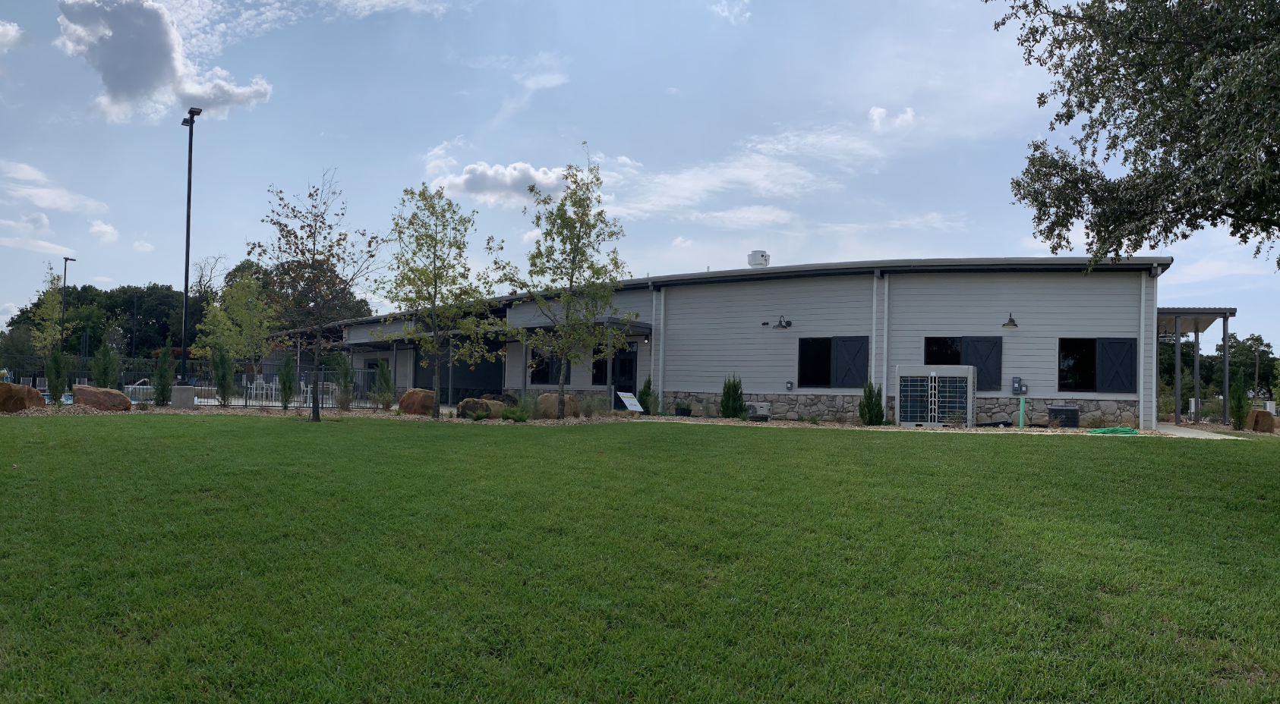
Why this location?
Location
Land
Located in Cross Roads, TX
Near two large major universities (UNT/ TWU)
10 minutes away from major cities (Denton & Frisco) that provide clients opportunities
Land is cheaper on outer edge of DFW
Country like feeling that is very beautiful and nature based
Notes:
Land was cheaper on the outer edge of the DFW metroplex
We are juxtaposed to two, 4 year public universities (UNT/TWU) that provide a rich source of staffing, educational and recreational opportunities for our clients.
Cross Roads is unique in that the property itself feels “country-like” but we are 10 minutes from the universities and cities of Frisco and Denton both of which house a robust source of employment./social/educational and recreational opportunities available to our clients.
The property is very beautiful and nature based which are residents and staff seem to like very much

Slide 16
Things to Consider: Lessons Learned
Raw Land
We started with “almost” raw land. Expanding the water line and pre development work were costly
Transportation
Limited public transportation, we have found ways to be very creative but it is costly
Leadership Team
Invest and build a strong leadership team sooner than later Heavy emphasis on BCBAs
Pace Yourself
Our residents moved in during covid and then due to need we built 2 more houses soon thereafter. That was hard.
Culture Keeper
Strive for a company-wide healthy culture: demands a great deal of attention and resources.
Notes:
We started with almost raw land. Ie. we had to enlarge the water line to the property and perform a lot more pre-development work which was costly. Starting the build with a more developed property would have saved money and time.
Transportation: we have limited public transportation which is costly and has forced us to become very creative with our transportation needs. More walkable property would have helped with our transportation needs.
Transportation = expensive (16 cars and a driver)
Public transportation in DFW is very hard / bad
Move a little slower-we moved our residents in during covid (everyone wanted to move in as soon as we opened in 7/2020) and then due to need (and a generous donor) we built 2 more houses soon thereafter and those also filled quickly. That was hard. Every house is different based on client’s needs.
Would have invested in and built our current leadership team quicker and sooner. It’s tough being a startup because you’re very worried about spending money and pulling in enough revenue to make payroll. Plus you’re also learning your way and while we gained much insight from other leaders (like Denise) no two properties or communities are the same and you still have to make it work yourself.
Support services are far more important than the real estate
Staffing and being a “culture-keeper” is challenging and demands a great deal of attention as well as resources.
Look for “Culture keeper” (people) company wide approach from the beginning
Leadership - BCBAs to direct the program

Slide 17
Funding the Property
Identify Property
Family Involvement
Bank
The property was Identified by founders then donated
Social impact investment from 22 families with the loan later being paid back to families
Small events at private homes with personal connections/ donors
Remainder of funding mortgaged
Grants were not possible without proof of concept
Notes:
The property itself was donated to the organization once identified by the founders
Seed money for the build was secured through social impact investments from 22 families.. This loan was later paid back to families and all but 1 donated the interest earned back to 29 Acres.
The rest of the seed money was secured through small events (gatherings in homes, personal connections to donors, etc)
Grants were not possible to secure at that time because we were a young organization and had no proof of concept
The rest of the money for the build was borrowed from the bank

Slide 18
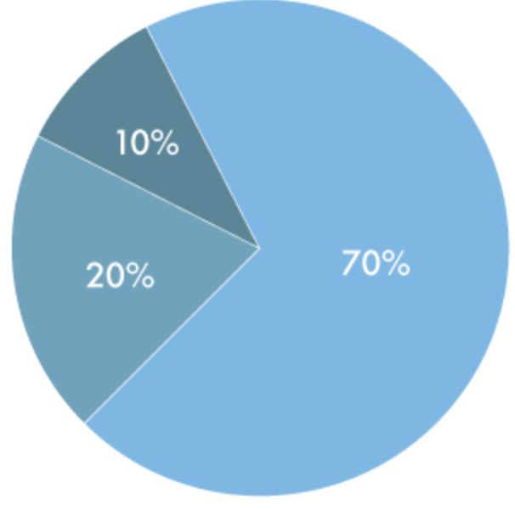
Funding Sources
Utilize Private & Public Partnerships
Some scholarships from fundraising
We believe these different revenue streams are necessary long term, especially when supporting individuals with higher support level needs
Private Pay
Some state funding (waivers for LTSS and Texas Workforce Commission for employment)
Notes:
Utilize private/public partnerships:
Our revenue streams are private pay and acceptance of some state funding (waivers for LTSS and Texas Workforce Commission for employment). We are a 501C3 and have 2 major fundraising events every year which help to provide partial scholarships based on need.
We believe these different revenue streams are necessary long term especially when supporting individuals with higher support level needs (it’s so expensive). It also comes with it’s challenges due to inadequate rate reimbursements from the state.

Slide 19
Reimbursement Rates
 |  |  | DAILY STAFFING AND CARE COSTS - EXCLUDES RENT
 |  |  | A | B | C | A+B+C=D | E | D-E=F
Setting | Level of Need (see below for description) | Staffing Ratio | Attendant Labor Cost ($17/hr + OH = $20/hr) | Indirect Care Costs | Reasonable Profit (10%) | Sum: Reasonable HHCS Rate | Less: Actual Reimb from HHSC | Provider Profit/Loss
Group home of 4 residents | LON 1 (Intermittent) | 1:4 for 3.5 hours + Overnight | $117.25 | $46.90 | $16.42 | $180.57 | $469.00 | $304.85
Group home of 4 residents | LON 5 (Limited) | 1:4 for 10 hours + Overnight | $360.00 | $144.00 | $50.40 | $554.40 | $632.00 | $128.00
Group home of 4 residents | LON 8 (Extensive) | 1:2 for 10 hours + Overnight | $560.00 | $196.00 | $75.60 | $831.60 | $684.16 | -$71.84
Group home of 4 residents | LON 6 (Pervasive) | 1:1 for 10 hours + Overnight | $960.00 | $288.00 | $124.80 | $1,372.80 | $771.20 | -$476.80
Group home of 4 residents | LON 9 (Pervasive+) | 1:1 for 16 hours + Overnight | $1,440.00 | $432.00 | $187.20 | $2,059.20 | $1,120.96 | -$751.04

Slide 20
Advocacy Work
We have spent the past 2 years working to allow the use of HCBS funding at our intentional community and just got through heightened scrutiny this month.
We are now launching additional advocacy work on rate reimbursements in Texas. Sadly, we are seeing Texas providers closing shop due to poor funding on the state level. Providers can’t staff with current reimbursement rates.
Notes:
We have spent the past 2 years working to allow the use of HCBS funding at our intentional community and just got through heightened scrutiny this month
Now we are launching advocacy work on rate reimbursements in Texas. Not only is this important for 29 Acres to be able to continue to accept state funding for LTSS, but we are seeing that Texas providers are closing their shop to Medicaid recipients due to poor funding from the state. They can’t staff with current reimbursement rates. So we have some work to do with rates.

Slide 21
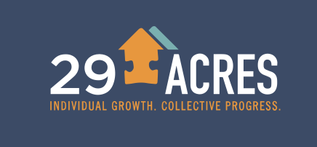
Thank You!
Morgan McKay, BCBA
COO
Morgan@29Acres.org
Debra Caudy, MD
Founder / CEO
Debra@29Acres.org
29 Acres
29acres
29 Acres

Slide 22
Final Settings Rule
What does it mean?
It’s based on autonomy and choice and includes considerations regarding ANE.

Slide 23
HCS settings must have all of the following qualities:
Setting supports full access to the community
Ensures individual rights of privacy, dignity and respect, and freedom from coercion and restraint
Optimizes autonomy and independence in making life choices
Facilitates choice regarding services and who provides them
Providers that offer services must make sure services:
Do not discriminate in any way
Provide services in the most integrated setting
Are chosen from a variety of options
Provide opportunities to seek employment and work in competitive integrated settings
Do not isolate individuals from the community

Slide 24
Requirements for Residential Settings:
Individual has a lease
Has privacy (lockable doors, choice of roommates, and freedom to furnish or decorate the unit)
Control their own schedule including access to food at any time
May have visitors at any time
The setting is physically accessible

Slide 25
Person Centered Planning
Each client has a life plan
The client is the center of the plan
The client and/or guardian is the one making the choices
This document shows what is important to them, what they value, likes/dislikes, how they want help in the community
At 29 Acres
Updates are at least 3 times a year at their Circle of Support meeting - to review progress
Staff at 29 Acres is not making choices for clients we are helping them live their very best lives!

Slide 26
Right Restrictions and Modifications
Any modifications of the settings rule requirements (like a camera which would be considered a violation of privacy) must be supported by a specific assessed need and justified in the Person-Centered Support Plan (PCSP), with the following items documented in the plan:
Identify a specific and individualized assessed need
Include a clear description of the condition that is directly proportionate to the specific assessed need
Include established time limits for periodic reviews to determine if the modification is still necessary or can be terminated
Include the informed consent of the individual
Include an assurance that interventions and supports will cause no harm to the individual.

Slide 27
Community integration:
Access to engage in greater community activities for that particular individual- according to personal preference. Individuals (Or their guardians) must be able to control their own schedules and activities.
Ex. If Jon wants to horseback ride and his housemates does not - Jon will go, but his housemates doesn’t have to.
Everyday clients make choices
The goal is to be out in the greater community as much as possible

