Slide 1
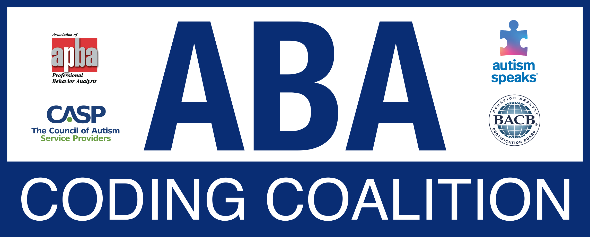
Updates
Autism Law Summit
Milwaukee, WI
October 13, 2023

Slide 2
Topics
Overview of the ABA Coding Coalition
  Composition and aims
  Website
Key resources
Recent activities
Updates

Slide 3



ABA Coding Coalition
Formed in 2019
Allyson Moore Wayne Fisher* Kelly Headrick Lorri Unumb*
Chanti Waters Jim Carr* Kristen Koba-Burdt
CPT® Consultant: Jenna Minton*, Proactive Strategies, LLC
ABA Consultant: Gina Green*
*Authors of code change application submitted by former ABA Services Work Group to AMA CPT® Editorial Panel in 2017 to modify Category III (temporary) codes for adaptive behavior/ABA services and upgrade them to Category 1. With CPT® Editorial Panel, also authored descriptors of CPT® codes that went into effect January 1, 2019 and article in November 2018 CPT® Assistant.

Slide 4
Principal Aims
Support implementation of the 2019 CPT® code set by ABA service providers and payers by responding to inquiries, developing and disseminating information and resources, and communicating with our constituents and other interested parties
Monitor Medically Unlikely Edits (MUEs) and National Correct Coding Initiative (NCCI) procedure-to-procedure edits for the code set and submit requests for revisions based on provider feedback and payer implementation
Educate ABA service providers and payers about CPT®, MUE, and related processes
Develop and maintain website (www.abacodes.org) as a repository for coding and reimbursement resources and a portal for inquiries

Slide 5
2019 Code Set
Category I codes:
Assessment
97151 (QHP)
97152 (technician)
Treatment, 1-to-1
97153 (technician)
97155 (QHP); may include simultaneous direction of technician
Treatment, group
97154 (technician)
97158 (QHP)
Family treatment guidance
97156 (QHP, one family, with or without patient)
97158 (QHP, multiple families, without patient)
Category III codes:
Assessment -- 0362T (QHP on site, 2 or more technicians, patient exhibits destructive behavior, environment customized to behavior)
Treatment -- 0373T (QHP on site, 2 or more technicians, patient exhibits destructive behavior, environment customized to behavior)

Slide 6
www.abacodes.org

Slide 7
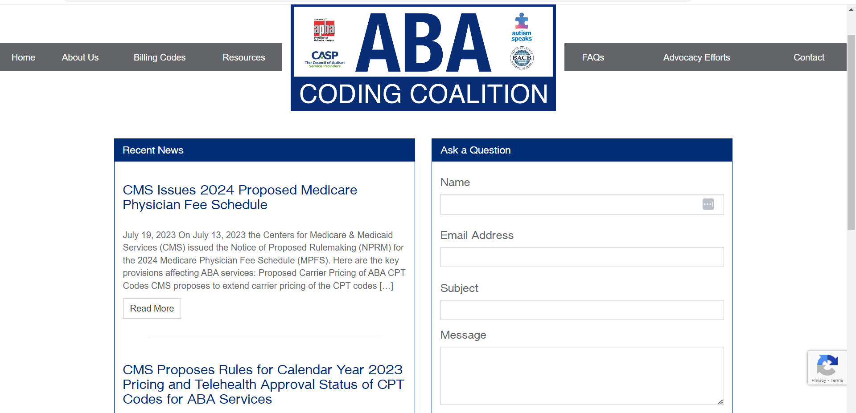

Slide 8
Questions portal
Ask a Question at www.abacodes.org
Since last year's Summit, we have answered 219 questions submitted via the portal on the homepage (average: about 18 per month).
Topics include:
Payer requests for input on draft policies or interpretations of codes.
Parent inquiries about coverage of ABA services and working with health plans.
Provider inquiries on all things related to the ABA code set, including payer policies.

Slide 9
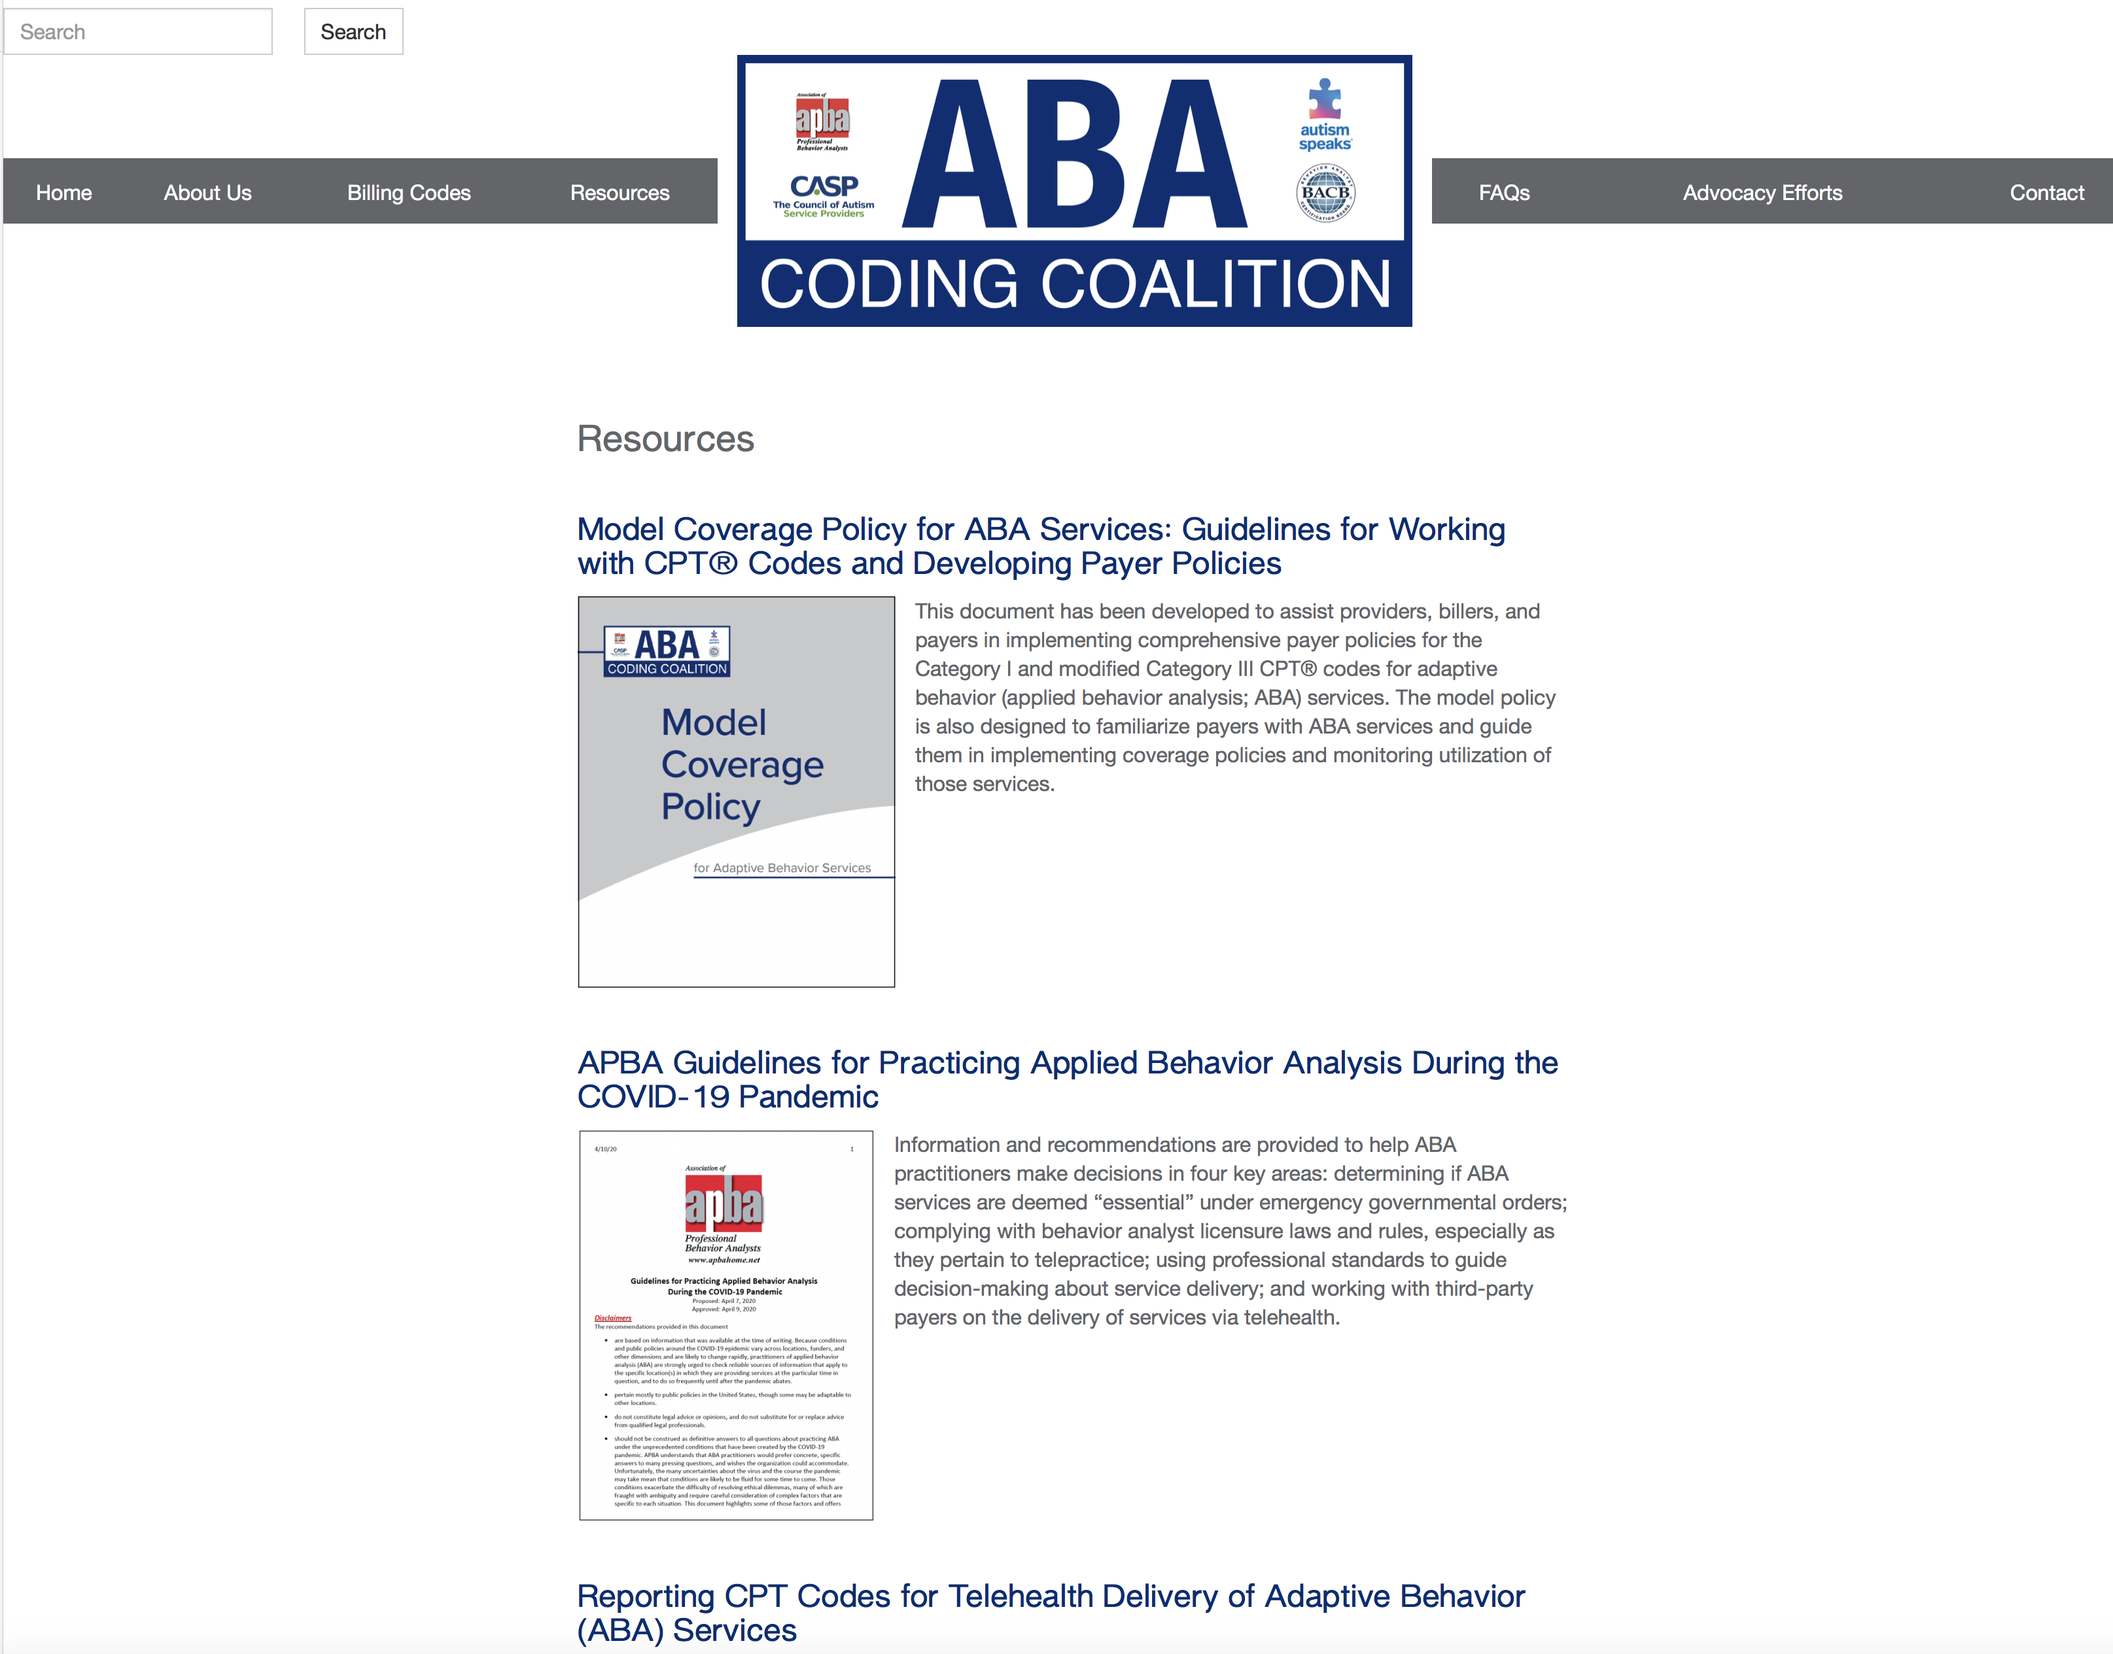

Slide 10
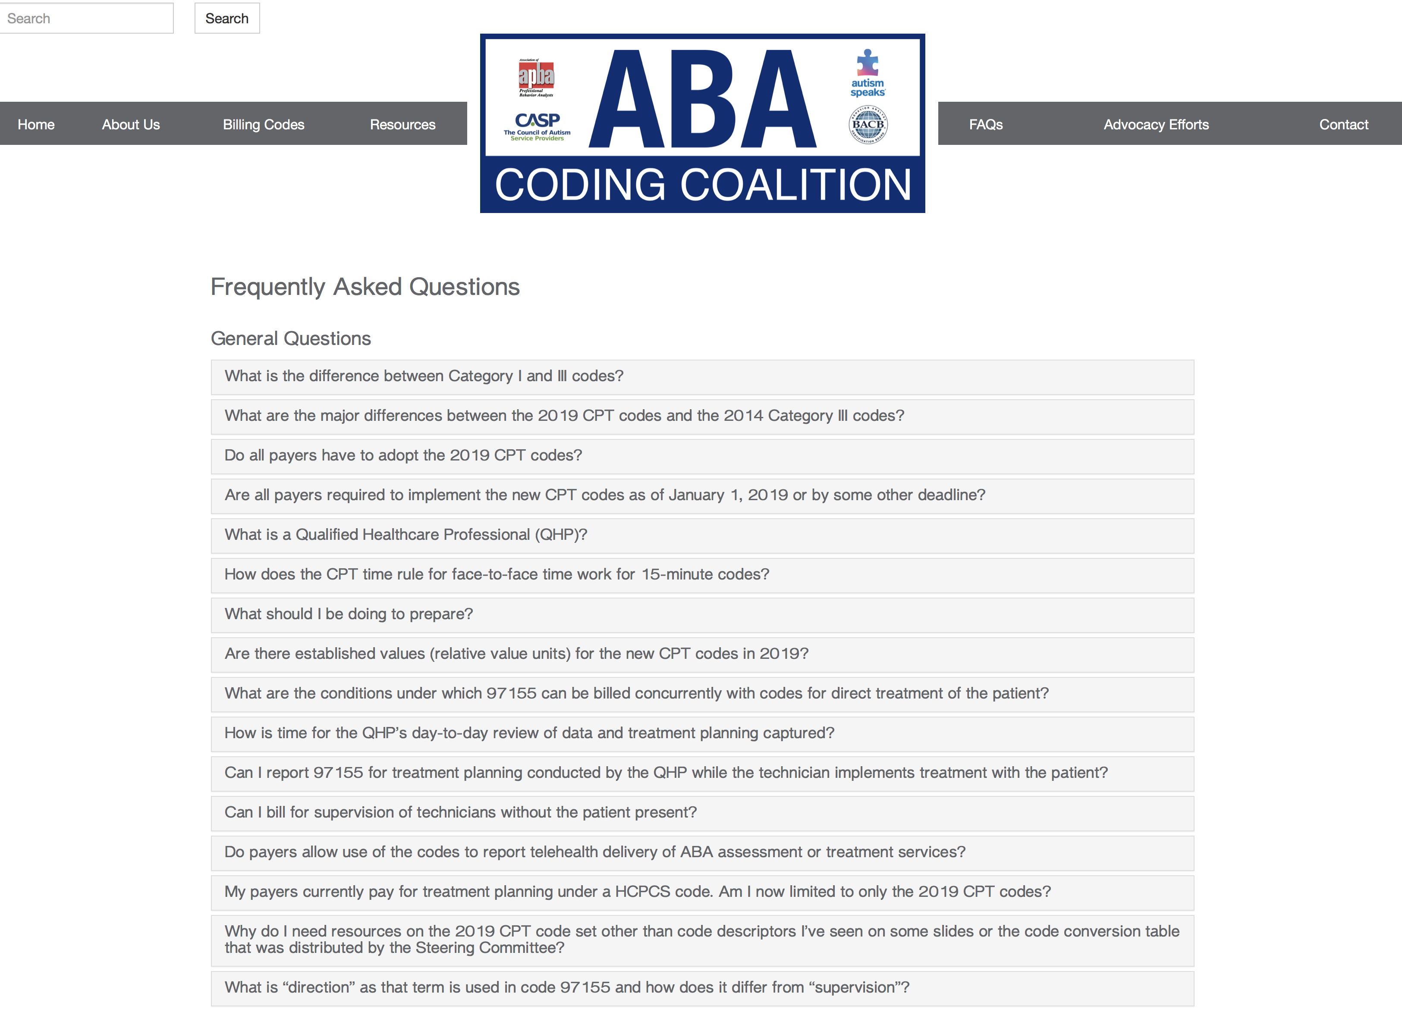

Slide 11
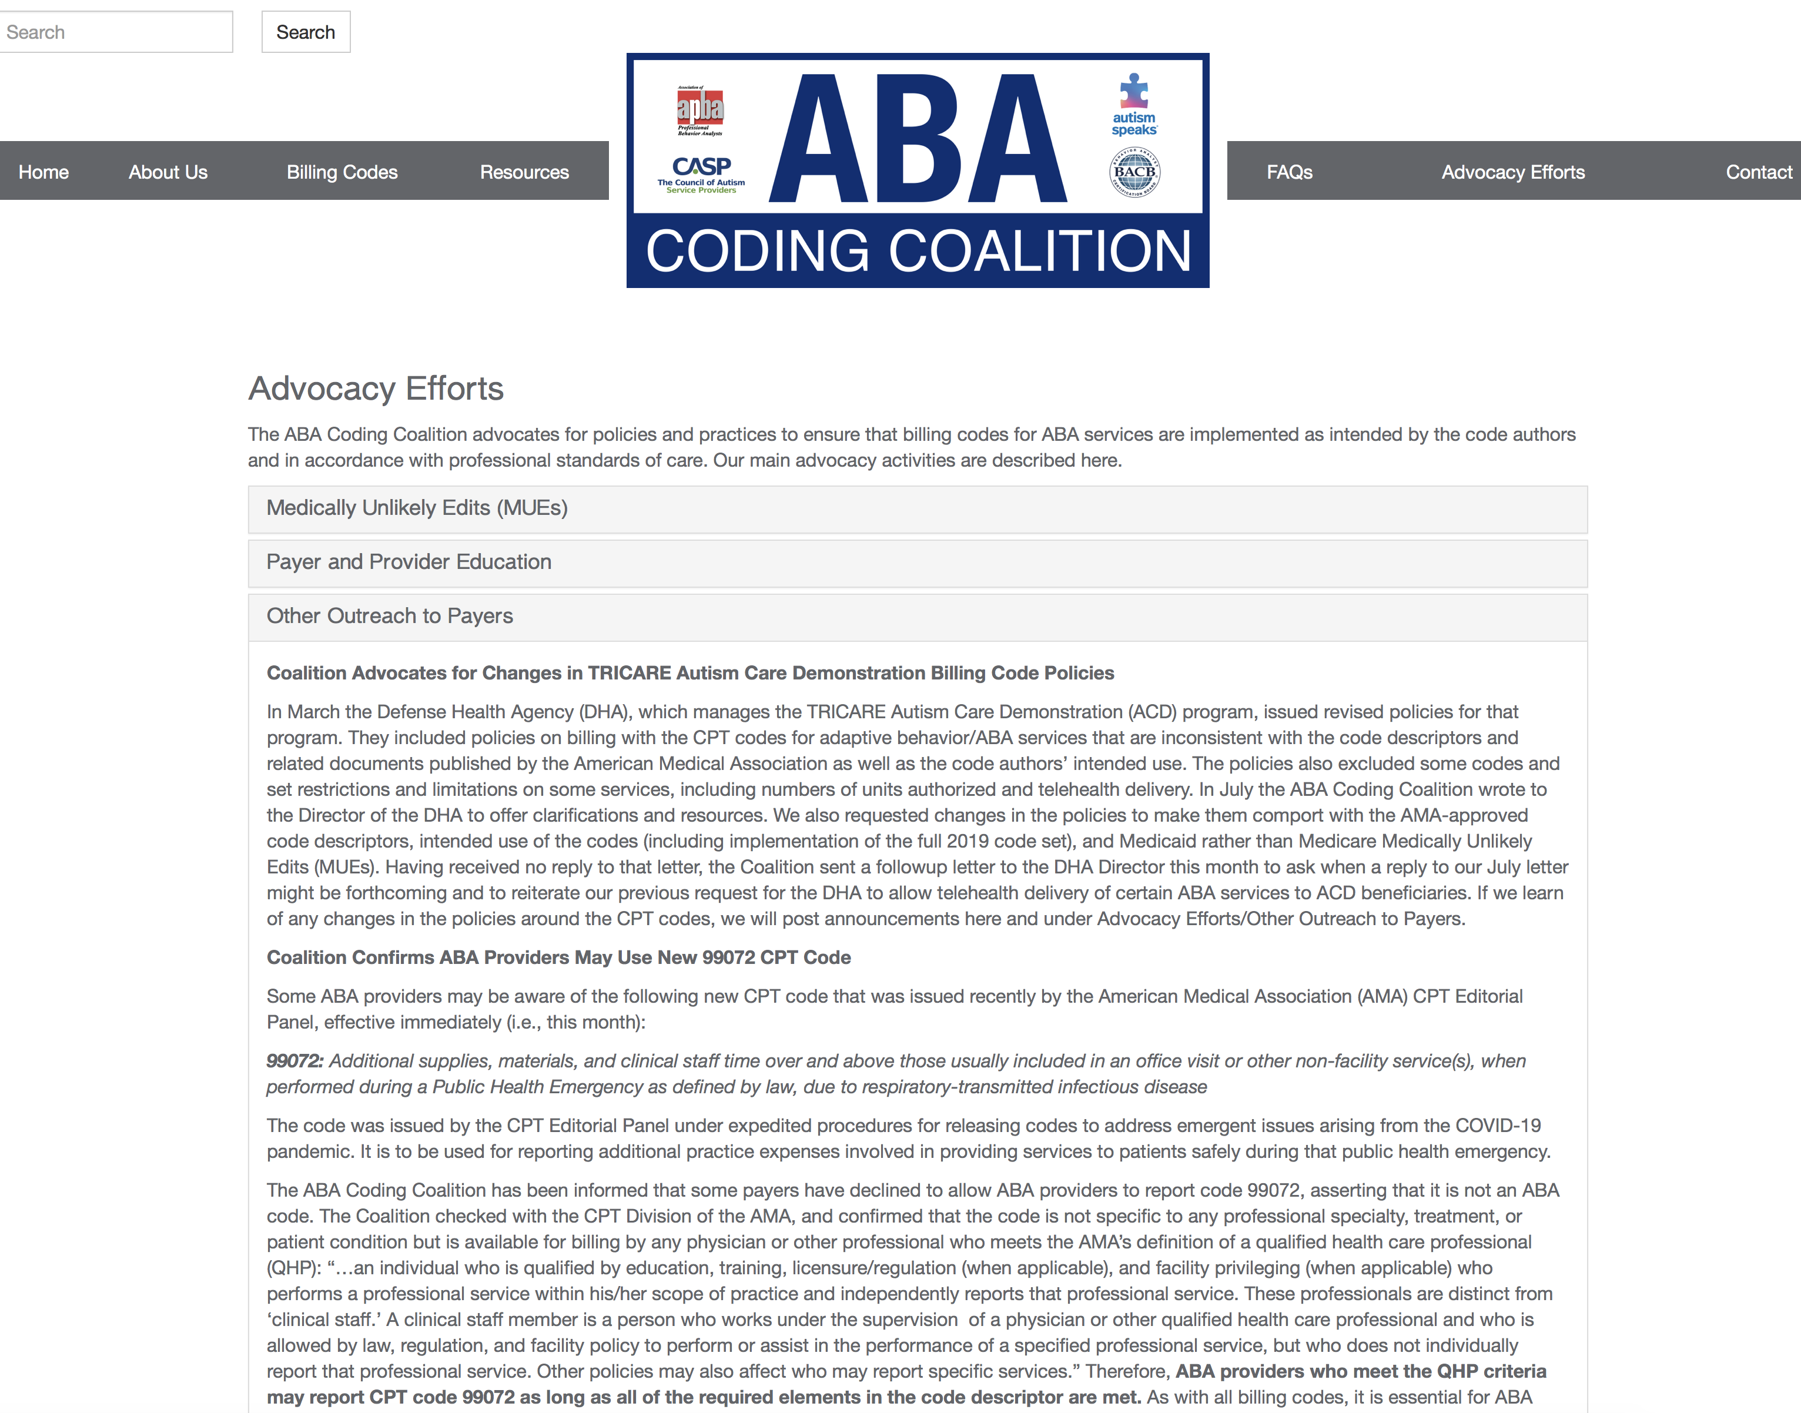

Slide 12
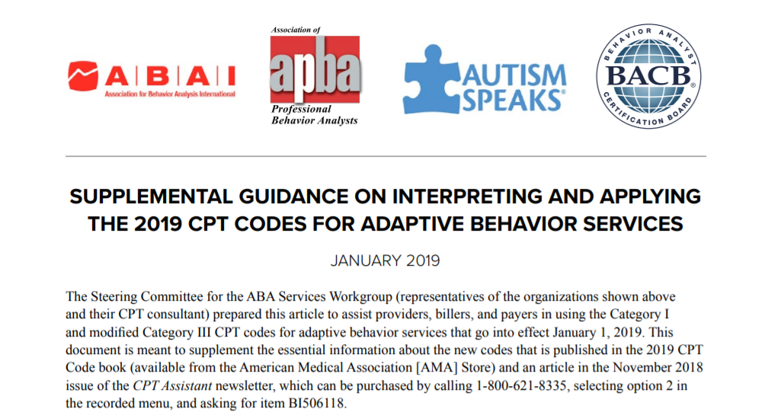
KEY RESOURCES AT WWW.ABACODES.ORG
Supplemental Guidance article
  Written by former ABA Services Work Group Steering Committee to assist providers, billers, and payers in using the 2019 CPT codes

Slide 13
Supplemental Guidance article includes
  Code descriptors
  Clinical examples, including direct and indirect components of each service/code.
  Typical patient vignettes
  FAQs on individual codes as well as broader concepts around reporting the codes
  NOTE: Code descriptors, clinical examples, and vignettes are not specific to any diagnoses or patient populations.

Slide 14
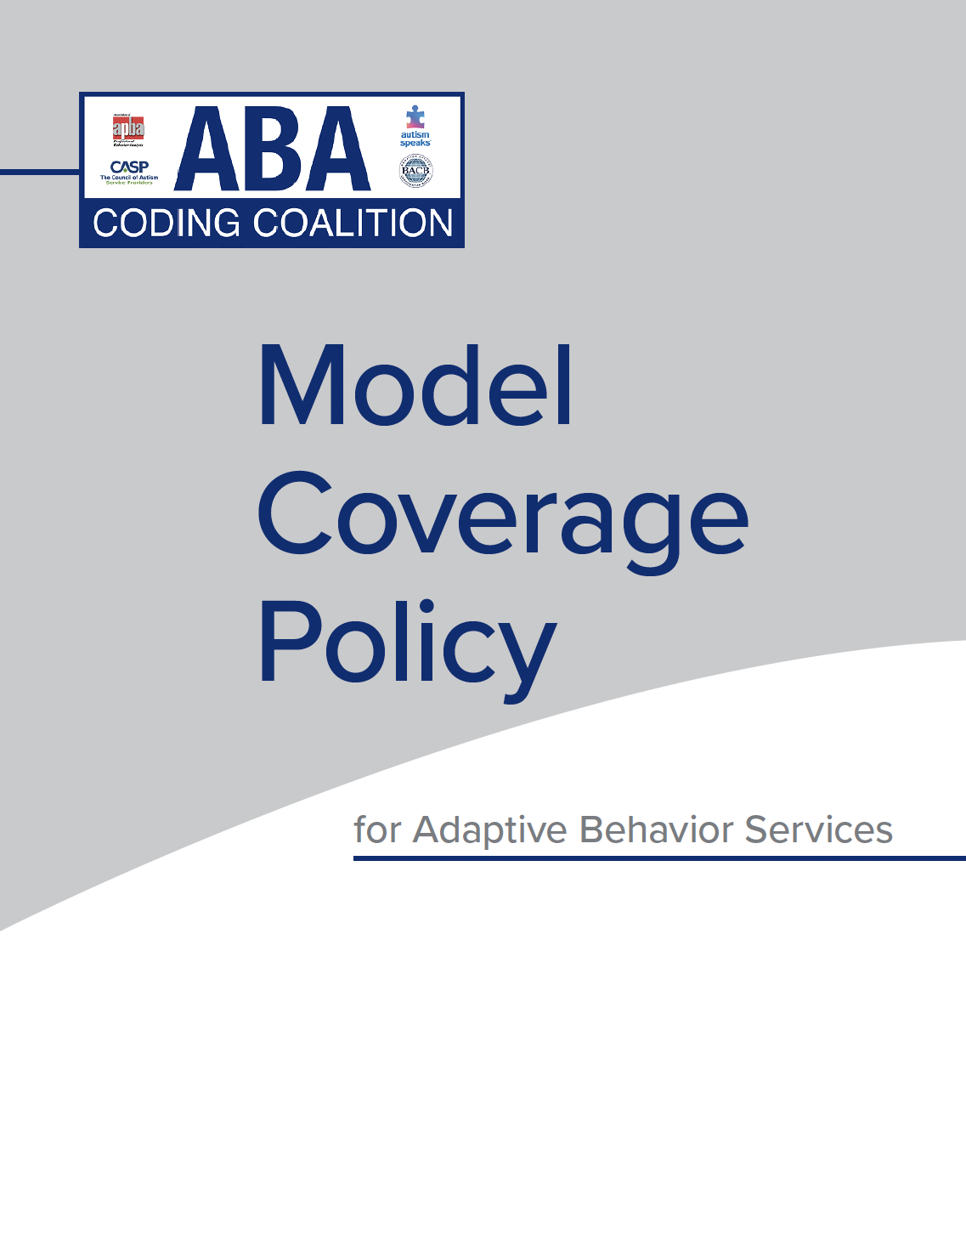
Available under Resources at www.abacodes.org and Practice Guidelines at www.apbahome.net

Slide 15
Model Coverage Policies
Outline optimal coverage parameters for healthcare procedures or therapies that may be new or unfamiliar to health plans for payers, providers, and billers.
Are often developed by national specialty societies in the absence of a Centers for Medicare & Medicaid Services (CMS) local or national coverage policy, or in response to wide variance in payer coverage policies for a specific service or specialization.

Slide 16
Model Coverage Policies
Benefits of a model coverage policy:
  Provides detail a contract cannot
  Serves as a road map for the day-to-day delivery of services and reporting of claims
  Serves as a guide for providers on initial authorizations, parameters around delivery of care, claims submission, and payment or appeal processes.

Slide 17
ABA Coding Coalition Model Coverage Policy
Designed to guide providers, billers, and payers in working with the 2019 CPT codes for adaptive behavior/ABA services to develop appropriate coverage policies and monitor utilization for any patients for whom the services are medically necessary.
Includes:
  indications
  limitations
  billing codes
  provider qualifications
  documentation requirements
  other general information
  a bibliography of research on the efficacy of ABA services for several patient populations.

Slide 18

General Coverage Requirements
Requested services must be medically necessary.
  Needed to ameliorate symptoms of a diagnosed disorder, build adaptive behaviors, and/or reduce maladaptive behaviors to enhance the patient’s health, safety, and overall functioning and/or to prevent deterioration or regression.
Determinations of medical necessity must not be based on hard, fixed, or arbitrary limits, but should be
  individualized and
  based on generally accepted standards of care.

Slide 19

Using the Model Coverage Policy
Payers:
  Consider implementing the model coverage policy in place of existing policies or to enhance existing policies.
Providers:
  Use it in communicating with payers about coverage determinations, profession’s standards of care.
EMR companies and billers:
  Read it, learn it, integrate it into your systems.
  Have it at the ready when working with health plans.

Slide 20
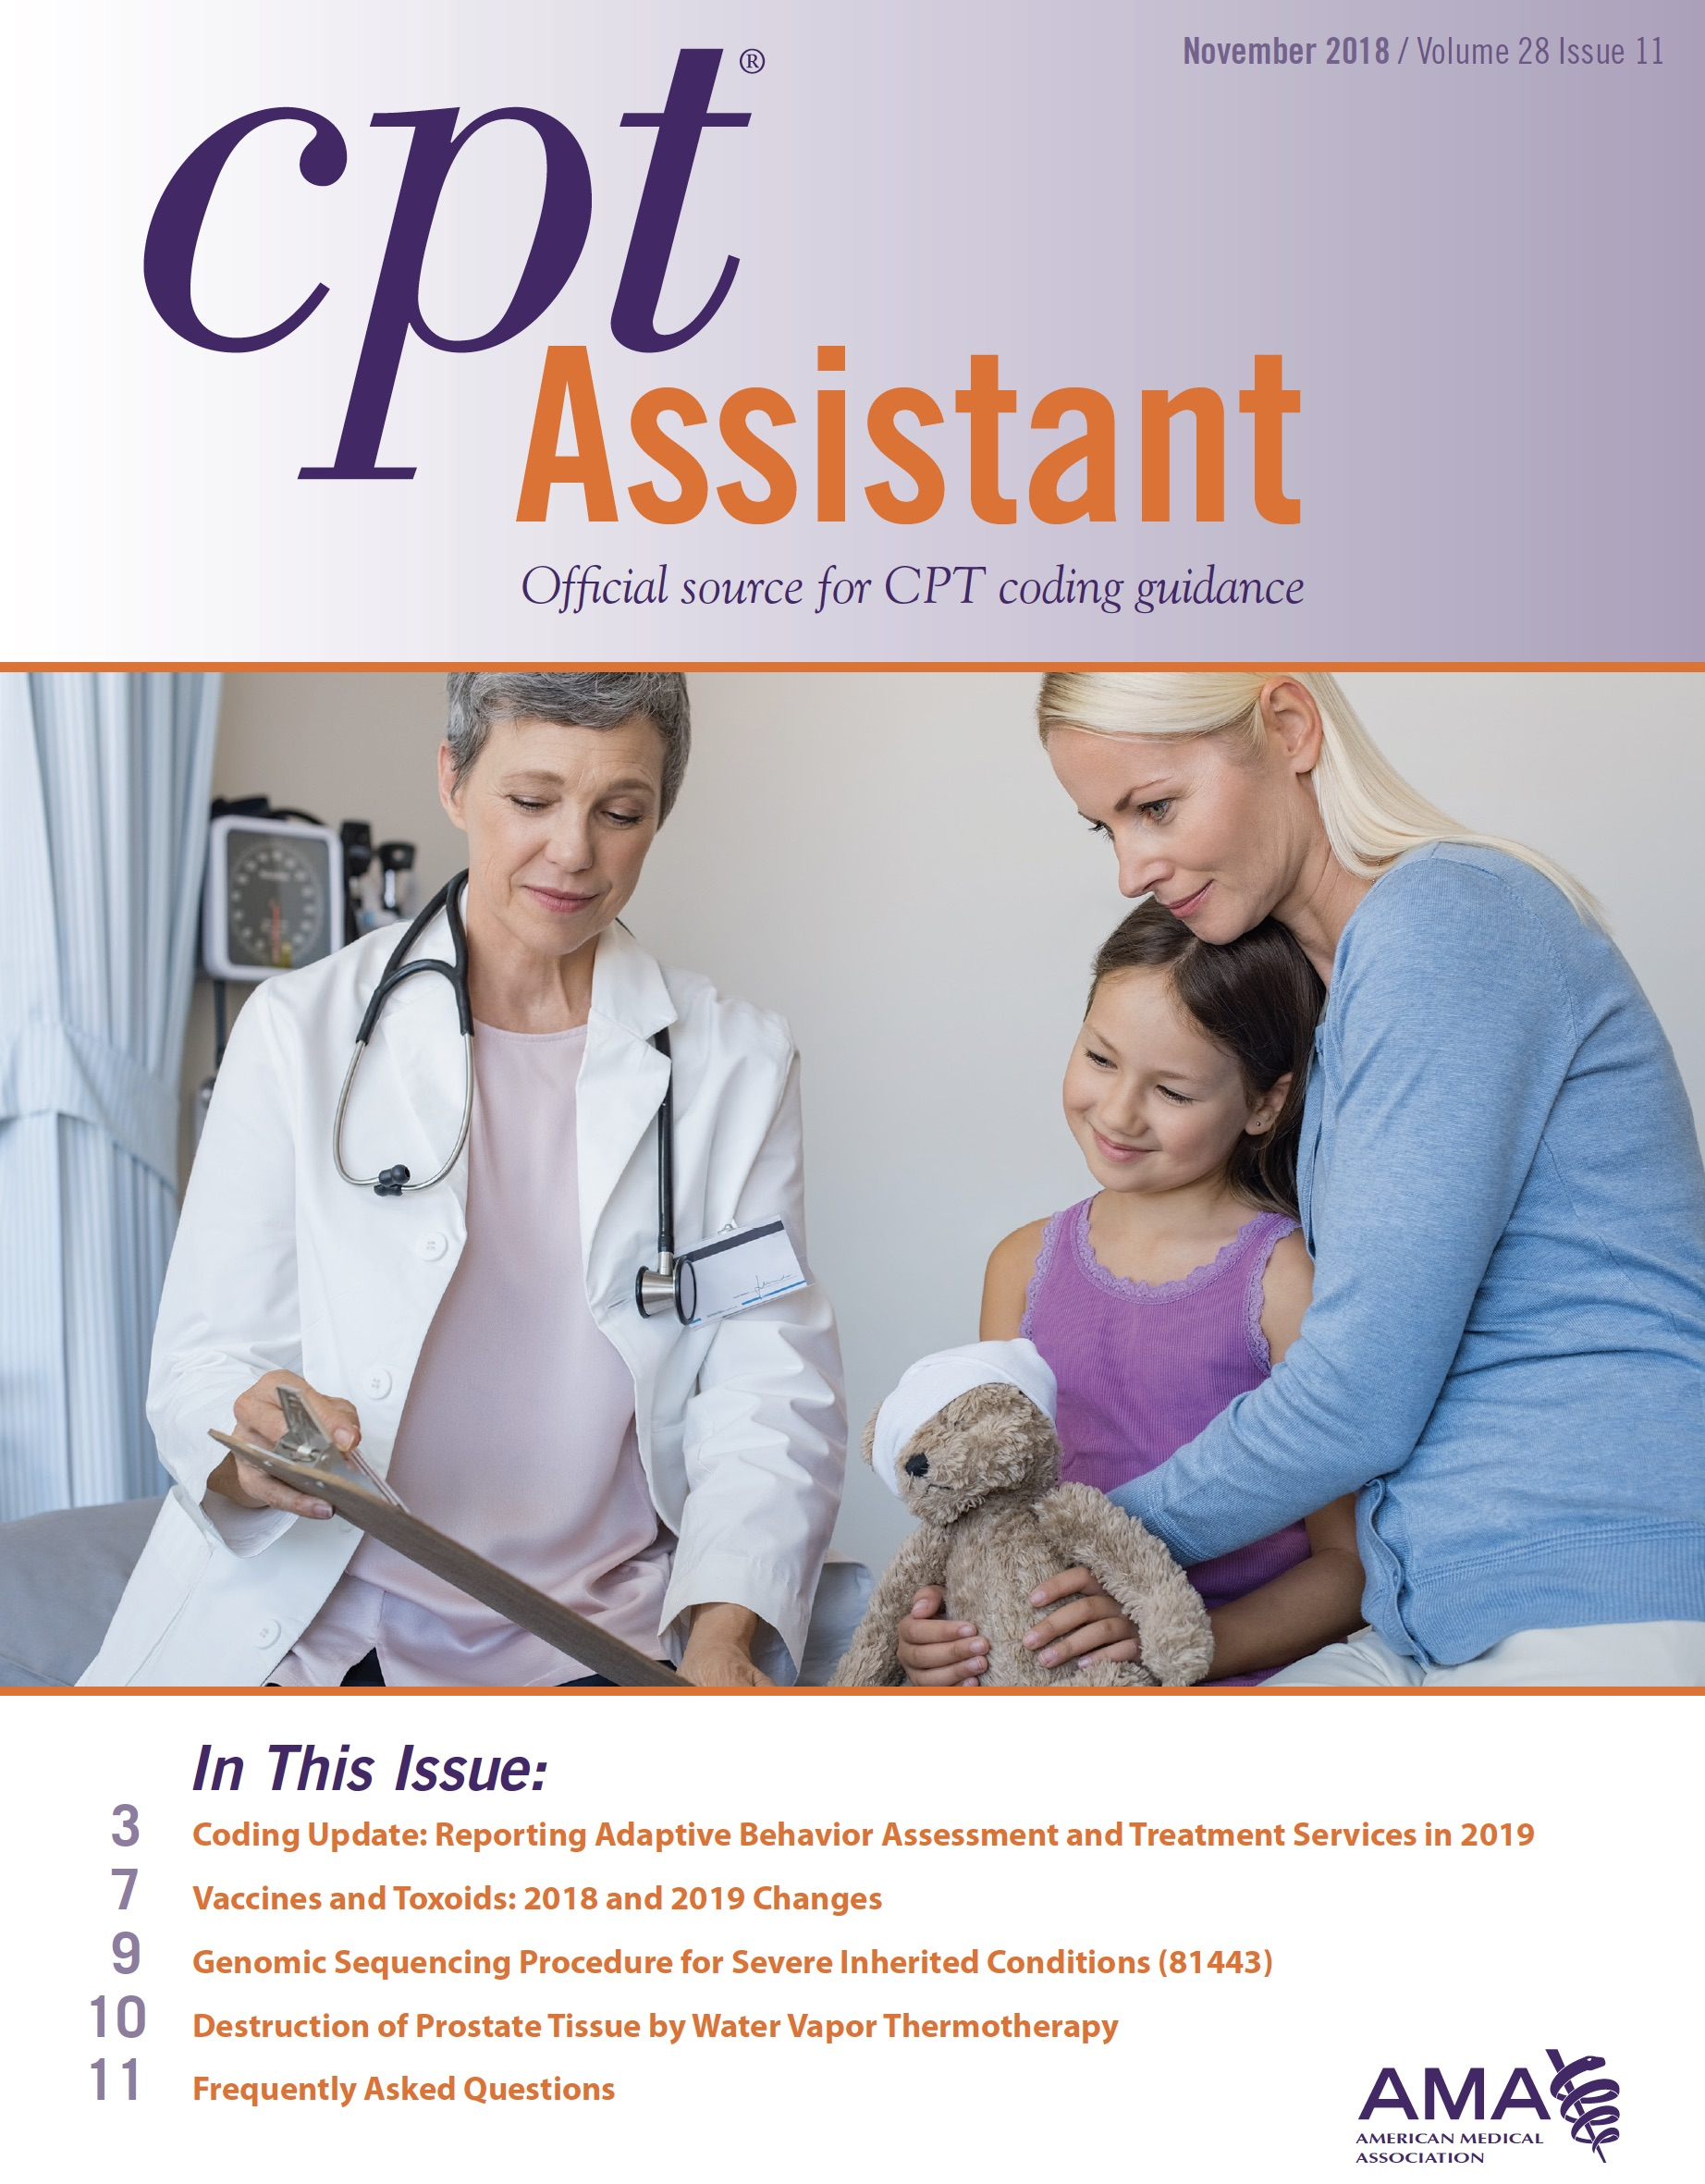
Other Key Resources
November 2018 CPT®️ Assistant article
  CPT®️ Assistant: Newsletter published by the AMA; provides guidance to providers around coding changes or development of new CPT codes to ensure proper and accurate reporting (beyond what appears in the AMA code book).
  November 2018 issue includes article about the 2019 CPT codes for adaptive behavior/ABA services that is an essential resource for everyone who bills health plans for ABA services.
  AMA has granted the Association of Professional Behavior Analysts (APBA) permission to make that issue available to its members free of charge in the Members Only section of www.apbahome.net.

Slide 21

ABA CODING COALITION recent ACTIVITES

Slide 22
OUTREACH
Coalition
  Advocates for payers to implement the 2019 code set as intended by the authors and issued by the AMA
  Welcomes questions from and opportunities to collaborate with payers, and has met or corresponded with many since the current code set was issued.
Since the last Summit, Coalition has worked/is working with
  Aetna
  FL Medicaid
  HI Medicaid
  KS Medicaid
  ND Medicaid

Slide 23
Advocacy Efforts
Implementation of 2019 code set
  Coalition has reached out to several payers to urge
    Adoption of full code set as intended by authors and approved by AMA
    Authorization of 97152 (behavior identification supporting assessment by technician) to supplement assessment info gathered by behavior analyst under 97151 (behavior identification assessment by QHP)
    Concurrent billing, especially 97155 (adaptive behavior treatment with protocol modification/simultaneous direction of technician by QHP) and 97153 (adaptive behavior treatment by technician)
    Authorization of sufficient units to be consistent with scientific evidence, profession’s standards of care, medical necessity

Slide 24
Advocacy Efforts
Medically Unlikely Edits
  Centers for Medicare & Medicaid Services (CMS) contracts with National Correct Coding Initiative (NCCI) to establish coding edits.
  Medically Unlikely Edits (MUEs): Maximum units of service that a provider would report under most circumstances for a single beneficiary on a single date of service. Not meant to be used as hard caps.
  Many payers mirror Medicare MUEs, which often differ from Medicaid MUEs for the same codes.
  ABA Coding Coalition advocates for use of Medicaid rather than Medicare MUEs, as the former are more appropriate for ABA services and patients.
    But we also continue to advocate for CMS to increase Medicare MUEs for some ABA CPT codes (e.g., 97151).
  See MUEs under Advocacy at www.abacodes.org.

Slide 25
Updates
  Added to website FAQs on 0362T and 0373T to clarify the meaning of “destructive behavior:”
  Q: What is meant by “destructive behavior”? Is it limited to self-injury, property destruction, and the like?
  A: As indicated in the article about the 2019 adaptive behavior/ABA services CPT codes in the November 2018 issue of the American Medical Association CPT® Assistant newsletter, destructive behaviors include but are not limited to “… self-injurious behavior, aggression, property destruction, pica, elopement, and other behaviors associated with high-risk medical consequences or property damage” (p. 4). That encompasses any behaviors that jeopardize a patient’s health or safety and for which research documents that ABA services are effective for preventing or reducing the risk of medical consequences, i.e., injuries and/or health problems. Examples in addition to those just listed include but are not limited to feeding difficulties, sleep difficulties, rumination, bruxism, mouthing objects, inadequate fluid intake, skin picking, resistance to or lack of cooperation with dental and medical care procedures, and other behaviors that may result in the need for medical treatment. CPT codes 0362T and 0373T are appropriate for reporting ABA assessment and treatment of such behaviors if all required elements of those codes are met (QHP/behavior analyst on site, two or more technicians, environment customized to patient’s behavior).

Slide 26
Important update - 2024 MPFS PROPOSAL RE: VALUATION OF ABA CODES
In July 2023, the Centers for Medicare & Medicaid Services (CMS) published the proposed Medicare Physician Fee Schedule (MPFS) and proposed rule changes for 2023. The agency is proposing that the CPT codes for adaptive behavior/ABA services (97151 – 97158, 0362T, 0373T) remain carrier-priced throughout 2024, as they have been since they went into effect January 1, 2019.
We anticipate that the final rules for the 2024 MPFS will be published in November and will post an update in Recent News on the website at that time.

Slide 27
Important update – Telehealth coverage application to cms
CMS reported receiving 9 applications (one of which was from the Coalition) to add certain CPT codes to the list of those that are approved for telehealth delivery on a permanent basis. Two of those applications pertained to codes for therapeutic services. In the NPRM, CMS stated that they believe adding those codes to the permanent Medicare telehealth list would create confusion. As in the final rules for 2023, CMS noted that they do not have the authority to expand the list of eligible Medicare telehealth practitioners to include therapists after 2024 (citing regulations 87 FR 69449 – 69451) because the federal Consolidation Appropriations Act (CAA) of 2023 did not change the list of practitioners who can furnish and bill for telehealth services permanently.
Rather, the CAA extended current telehealth flexibilities through the end of 2024. Therefore, CMS proposes to retain all CPT codes for therapeutic services as telehealth Category 3 (temporary) through December 31, 2024. That includes the adaptive behavior/ABA services codes (97151-97158, 0362T, 0373T).

Slide 28

frequently asked questions

Slide 29
What aRE direct serviceS?
All ABA CPT codes require face-to-face time with the patient or caregiver (except for 97151, where indirect time can be counted too). This is direct service time and is billable.
The provider must be engaged in delivering services directly to the patient or caregiver. Other services performed in the presence of the patient or caregiver but without their active engagement are indirect and not billable.

Slide 30

What ARE indirect services?
An indirect service is one that does not involve active delivery of services to a patient or caregiver. That includes activities like updating written protocols and treatment plans, graphing data, writing session notes, and preparing or cleaning up the treatment space/room.
There is no separate code for indirect services in the 2019 CPT code set (nor was there in the Category III CPT code set). Some payers may supplement the CPT codes with a HCPCS or other CPT code (e.g., H0032, G9012, H2019) for reporting indirect activities. If a payer does not, activities that occur prior to and after face-to-face time should be bundled so that reimbursement for those codes captures both face-to-face and non-face-to-face time.

Slide 31
WHAT IS A QHP?
Qualified Healthcare Professional (QHP)
In 2013 the American Medical Association (AMA) established a definition of a qualified healthcare professional (QHP) for purposes of reporting healthcare services: “A ‘physician or other qualified health care professional’ is an individual who is qualified by education, training, licensure/regulation (when applicable) and facility privileging (when applicable) who performs a professional service within his/her scope of practice and independently reports that professional service.”
Possible QHPs for the 2019 CPT codes for adaptive behavior (ABA) services are
Licensed Behavior Analysts
Board Certified Behavior Analysts, Board Certified Behavior Analysts-Doctoral
Other licensed professionals who have behavior analysis in their profession’s scope of practice and their individual scope of competence.

Slide 32
Can a BCaBA/LABA Bill QHP Codes?
No, because Board Certified Assistant Behavior Analysts/Licensed Assistant Behavior Analysts cannot practice independently.
Payer policies vary, however. Some health plans may allow BCaBAs/LABAs, individuals who are not certified or licensed in the practice of behavior analysis, etc. to render the QHP codes for ABA services.

Slide 33
what services/codes cannot be billed with ABA SERVICES?
National Correct Coding Initiative Edits
Part of the NCCI process includes setting procedure to procedure edits (i.e., what services/codes can be billed together on a given date of service).
- Some examples include limitations on ABA and speech or psychotherapy services being billed at the same time (concurrently).
- Reports of these issues are really ramping up!

Slide 34

WHAT ARE ROUNDING RULES?
With time-based CPT codes, a service may be reported when half the time increment specified in the code descriptor has been met.
All of the 2019 CPT codes for ABA services are timed and in 15-minute increments, so work lasting 8 - 22 minutes is reportable as one unit. Work lasting less than 8 minutes is not reportable.

Slide 35
ROUNDING RULES (Cont’d
When a session begins late or ends early, it is essential to document the exact time the provider was actively engaged with the patient on the session note, even if the rounding rule will be used to determine the number of units billed.
  Example: If a session scheduled for 9 am – 12 pm ends at 11:55 am, record 9 am –11:55 am on the session note. 12 units could be billed because service was delivered for at least 8 of the final 15 minutes.
IMPORTANT: Using the rounding rule to intentionally and systematically end sessions early -- for example, to write session notes -- is likely to trigger an audit by the health plan.
Writing session notes does not constitute direct, face-to-face services, even if done in the presence of the patient.
Recording data on the patient's behavior during sessions is part of direct service and different from writing session notes. The latter should be done after the session has ended and the patient is no longer present.

Slide 36
Concurrent billing
Many think this term refers to services delivered to one patient on the same day (e.g., ABA and speech therapy on the same date of service)
In reality, it means AT THE SAME TIME. So to be concurrent, ABA and speech services would have to occur during the same time frame, not on the same date of service.

Slide 37

IS CONCURRENT BILLING ALLOWED?
The November 2018 AMA CPT ® Assistant article specifies that code 97155 (adaptive behavior treatment with protocol modification administered by QHP; may include simultaneous direction of technician) is intended to be reported with 97153 (adaptive behavior treatment by protocol administered by technician) when the QHP directs a technician who is implementing a protocol with a patient.
The AMA CPT® book includes no exclusionary parentheticals indicating that these services may not be reported concurrently.
Also see the Supplemental Guidance Article at www.abacodes.org
The services represented by 97155 and 97153 are separate and distinct, so billing them concurrently does not constitute duplication.

Slide 38
Concurrently billed code pairs
Direct Treatment Codes | Direction of Technician Code
97153 -- individual treatment by tech or QHP | 97155 – by QHP (not the same as QHP delivering 97153)
97154 -- group treatment by tech or QHP | 97155 – by QHP (not the same as QHP delivering 97154)
0373T -- individual treatment by two or more techs or two or more QHPs | NO ADDITIONAL CODE FOR DIRECTION OF TECHNICIAN; BUNDLED INTO 0373T BASED ON “ON SITE” REQUIREMENT

Slide 39
What is adaptive behavior service protocol modification?
Protocol modification includes but is not limited to
(a) adjustments to specific components of a protocol (e.g., treatment targets, treatment goals, observation and measurement, reinforcers, reinforcer delivery, prompts, instructions, materials, discriminative stimuli, contextual variables);
(b) observations to determine if the protocol components are functioning effectively for the patient or require adjustments;
(c) active direction of a technician while the technician delivers a service to a patient to ensure that the procedures are being implemented correctly, to correct errors in implementation, or to train the technician to implement a modified protocol; and
(d) QHP implementation of the protocol with the patient to determine if changes are needed to improve patient progress or to test a modified protocol.
Any protocol-modification services that are delivered during face-to-face sessions with patients or caregivers are billable. Modifying written protocols is an indirect service that is not reported separately, but is bundled with 97155 for payment.

Slide 40
HOW DO I REPORT GROUP CODES?
97154: Group treatment led by technician
    If a QHP joins the session to direct the technician on their implementation of protocols or to see if the protocol needs to be modified, report 97155 and 97154.
97158: Group treatment led by QHP
  97155 would typically not be reported concurrently with this code unless a separate QHP is directing the technician.
How do I report group services where some patients are 1:1 with technicians and others share a technician?
  Report 97153 for any patients who have a 1:1 technician
  Report 97154 for all patients who share a technician

